Slide 1
OPERATING SYSTEMS (CS F372) Introduction
Slides Courtesy: Dr. Barsha Mitra
CSIS Department, BITS Pilani, Hyderabad Campus

Slide 2
Handout Overview
Let’s go through the handout

Slide 3
Some Important Points
LOR requirement: ‘A’ grade and 90% attendance
Dishonesty penalty: 0 score in the component, including assignments, mid-semester examination and comprehensive examination
Report to Disciplinary Committee for repeat offenders
Assignments and tutorials will run on Ubuntu 20.04
Late Days Policy for Assignments:
A total 3 free late days are available for each student. The 3 days can be distributed between assignments 1 and 2 as the student wishes. Beyond the 3 free days a penalty of 10% per day will apply
Sign up on Piazza – non-negotiable
Attend classes and interact

Slide 4
What is an Operating System?
Let’s hear your thoughts

Slide 5
Introduction
Program that manages computer’s hardware
Acts as an intermediary between computer user and computer h/w
Several types, each type optimising different aspects
mainframe operating systems
personal computer (PC) operating systems
operating systems for mobiles platforms
(Question, what are the characteristics of these platforms which the OS needs to optimise for?)

Slide 6
What OS Does? : User View
Users want convenience, ease of use and good performance
Don’t care about resource utilization
Shared computer such as mainframe or minicomputer must keep all users happy
Users of dedicated systems such as workstations have dedicated resources but frequently use shared resources from servers
Handheld computers are resource poor, optimized for individual usability and battery life
Some computers have little or no user interface, such as embedded computers in devices and automobiles

Slide 7
What OS Does? : System View
OS is a resource allocator
Manages all resources
Decides between conflicting requests for efficient and fair resource use
OS is a control program
Controls execution of user programs to prevent errors and improper use of the computer

Slide 8

How do we define OS?
Everything a vendor ships when you order an operating system is a good approximation
“The one program running at all times on the computer”

Slide 9
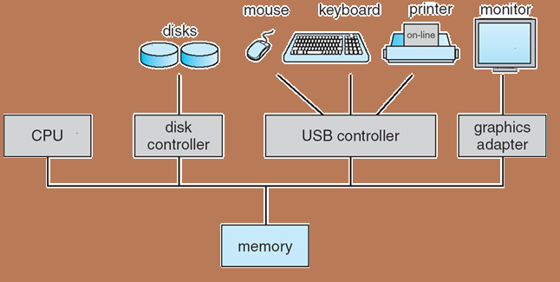
Computer System Organization
Computer-system operation
One or more CPUs, device controllers connect through common bus providing access to shared memory
Concurrent execution of CPUs and devices competing for memory cycles
device controller is a hardware component that works as a bridge between the hardware device and the operating system or an application program

Slide 10
Computer-System Operation
I/O devices and the CPU can execute concurrently
Each device controller is in charge of a particular device type
Each device controller has a local buffer
CPU moves data from/to main memory to/from local buffers
I/O is from the device to local buffer of controller
Device controller informs CPU that it has finished its operation by causing an interrupt
What is an Interrupt?

Slide 11
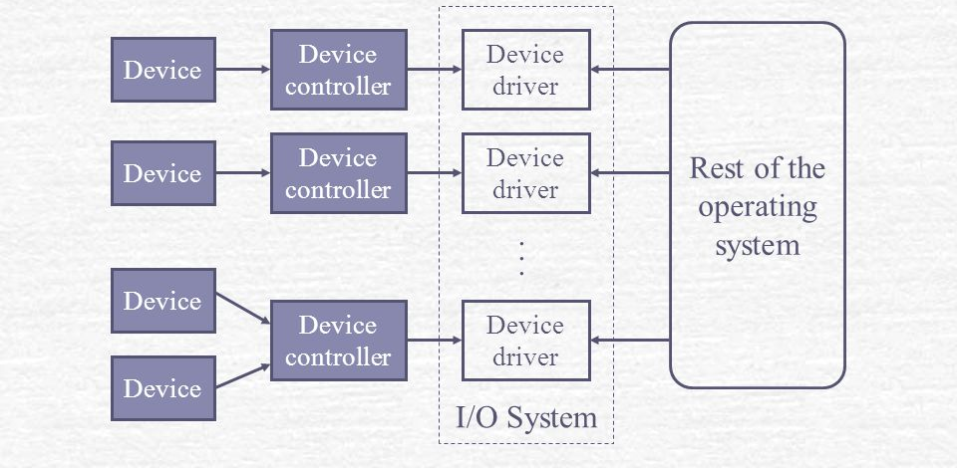
Computer-System Operation

Slide 12
Interrupt Handling
Interrupt transfers control to the interrupt service routine through the interrupt vector
IVT - contains the addresses of all the service routines
Must save the address of the interrupted instruction
Trap/exception is a software-generated interrupt caused either by an error or a user request
Operating system is interrupt driven
Operating system preserves the state of the CPU by storing registers and the program counter

Slide 13
Storage Structure
Main memory –
only large storage media that the CPU can access directly
instruction execution
random access
Volatile
Secondary storage (an example of I/O devices)
Cheaper, slower, non-volatile

Slide 14
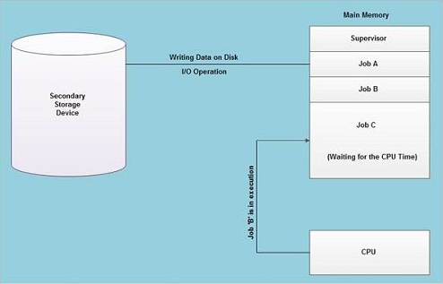
Operating System Structure
Multiprogramming (Batch system)
Needed for efficiency
Single process cannot keep CPU and I/O devices busy at all times
Organizes jobs (code and data) so CPU always has one to execute
A subset of total jobs in system is kept in memory
One job is selected and run via job scheduling
When it has to wait for I/O, OS switches to another job
Job Pool
CPU should not be Idle!!

Slide 15
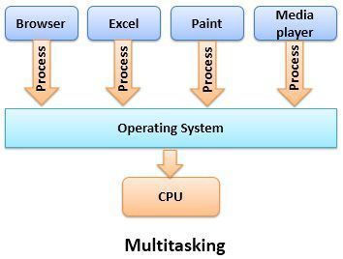
Operating System Structure
Timesharing (multitasking): CPU switches jobs so frequently that users can interact with each job while it is running
interactive computing
User interaction via input devices
Response time should be < 1 second
Different users have different programs in memory - process
If several jobs ready to run at the same time - CPU scheduling
If processes don’t fit in memory, swapping moves them in and out to run
Virtual memory allows execution of processes larger than physical memory
Here Focus is Responsiveness/
Response time.

Slide 16
Operating System Operations
Interrupt driven - hardware and software
Hardware interrupt by one of the devices
Software interrupt (exception or trap):
Software error (e.g., division by zero, invalid memory access)
Request for operating system service
Other process problems include infinite loop, processes modifying each other or the operating system

Slide 17
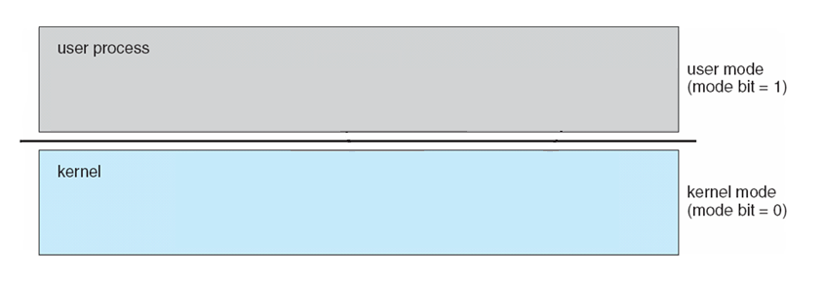
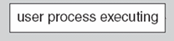
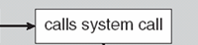
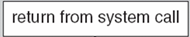
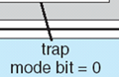
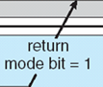
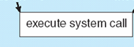
Operating System Operations
Dual-mode operation allows OS to protect itself and protect users from one another
User mode and Kernel/Supervisor/System/Privileged mode
Mode bit provided by hardware
Provides ability to distinguish when system is running user code or kernel code
Some instructions designated as privileged, only executable in kernel mode
System call changes mode to kernel, return from call resets it to user
locate ISR via interrupt vector and excecute

Slide 18
Operating System Operations
Boot time: hardware starts in kernel mode
After loading OS, user applications are started in user mode
When trap / interrupt occurs, hardware switches from user mode to kernel mode

Slide 19
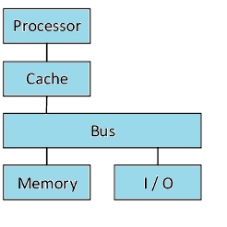
Computing Environments
Single-Processor Systems - one main CPU executing a general-purpose instruction set, including instructions from user processes, some device-specific processors like disk, keyboard and graphics controller and I/O processor may be present

Slide 20
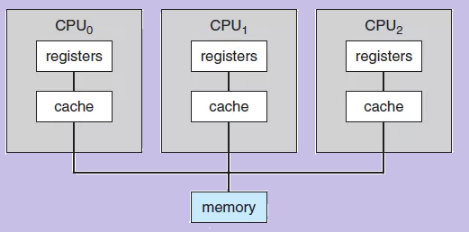
Computing Environments
Multiprocessors
Also known as parallel systems, multi-core systems
2 or more processors in close communication, sharing the computer bus and sometimes the clock, memory and peripheral devices
Advantages:
Increased throughput
Economy of scale
Increased reliability – graceful degradation, fault tolerance
Two types:
Asymmetric Multiprocessing – each processor is assigned a specific task, boss processor controls worker processors
Symmetric Multiprocessing – each processor performs all tasks, peers

Slide 21
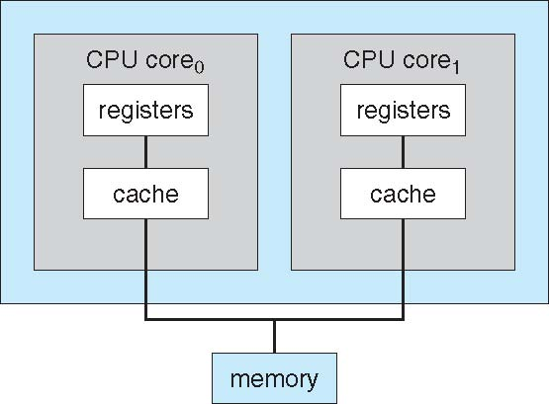
Computing Environments
Multicore Systems
include multiple computing cores on a single chip
more efficient than multiple chips with single cores because on-chip communication is faster than between-chip communication
dual-core design with both cores on same chip

Slide 22
Computing Environments
Clustered Systems
Like multiprocessor systems, but multiple systems working together
Usually sharing storage via a storage-area network (SAN)
Provides a high-availability service which survives failures, users can see only a brief interruption of service
Asymmetric clustering has one machine in hot-standby mode
Symmetric clustering has multiple nodes running applications, monitoring each other
Some clusters are for high-performance computing (HPC)
Applications must be written to use parallelization

Slide 23
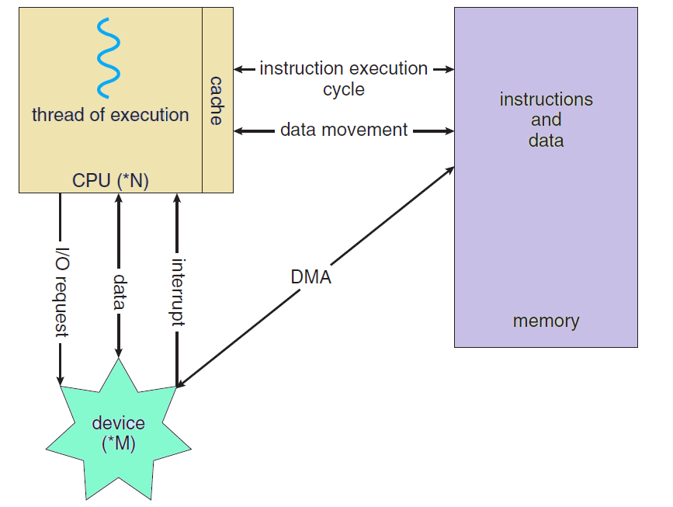
Putting it All Together

Slide 24
Primary Tasks for an OS
Process management
Memory management
Storage and I/O management

Slide 25
OPERATING SYSTEMS (CS F372) OS Structures

Slide 26
Operating System Services
User interface - almost all operating systems have a user interface (UI)
Command-Line (CLI), Graphics User Interface (GUI)
Program execution - system must be able to load a program into memory and to run that program, end execution, either normally or abnormally (indicating error)
I/O operations - running program may require I/O, which may involve a file or an I/O device, users don’t control, OS does
File-system manipulation - read and write files and directories, create and delete them, search them, list file Information, permission management

Slide 27
Operating System Services
Communications – processes may exchange information, on the same computer or between computers over a network, shared memory or message passing
Error detection –
OS needs to be constantly aware of possible errors
May occur in CPU and memory h/w, in I/O devices, in user program
OS should take the appropriate action to ensure correct and consistent computing
Debugging

Slide 28
Operating System Services
Resource allocation – allocating resources like CPU cycles, main memory, file storage, I/O devices for multiple concurrently executing processes
Accounting – keep track of which users use how much and what kinds of computer resources
Protection and security –
owners of information stored in a multiuser or networked computer system want to control use of that information
concurrent processes should not interfere with each other or with OS
ensuring that all accesses to system resources is controlled
security of the system from outsiders requires user authentication, extends to defending external I/O devices from invalid access attempts

Slide 29
Operating System Services

Slide 30
User and Operating-System Interface: CLI
CLI or command interpreter
Sometimes implemented in kernel, sometimes by separate program (Unix, Windows)
Sometimes multiple flavors implemented – shells
Primarily fetches a command from user and executes it

Slide 31
User and Operating-System Interface: GUI
User-friendly interface
Usually mouse, keyboard, and monitor
Icons represent files, programs, actions, etc.
Various mouse buttons over objects in the interface cause various actions (provide information, options, execute function, open directory (known as a folder))
Many systems now include both CLI and GUI interfaces
Microsoft Windows is GUI with CLI “command” shell
Unix and Linux have CLI with optional GUI interfaces (CDE, KDE, GNOME)

Slide 32

User and Operating-System Interface: Touchscreen Interface
Touchscreen devices require new interfaces
Mouse not possible or not desired
Actions and selection based on gestures
Virtual keyboard for text entry
Voice commands

Slide 33

User and Operating-System Interface:
Choice of Interface

Slide 34
System Calls
Interface to the services provided by the OS
Typically written in a high-level language (C or C++)
Mostly accessed by programs via a high-level Application Programming Interface (API) rather than direct system call use
API specifies a set of functions available to application programmers
Three most common APIs are
Win32 API for Windows
POSIX API for POSIX-based systems (including all versions of UNIX, Linux, and Mac OS X)
Java API for the Java virtual machine (JVM)

Slide 35
System Calls
A number is associated with each system call
System-call interface maintains a table indexed according to these numbers
The system call interface invokes the intended system call in OS kernel and returns status of the system call and any return values
The caller need know nothing about how the system call is implemented
Just needs to obey API and understand what OS will do as a result of call execution
Most details of OS interface hidden from programmer by API
Managed by run-time support library (set of functions built into libraries included with compiler)

Slide 36
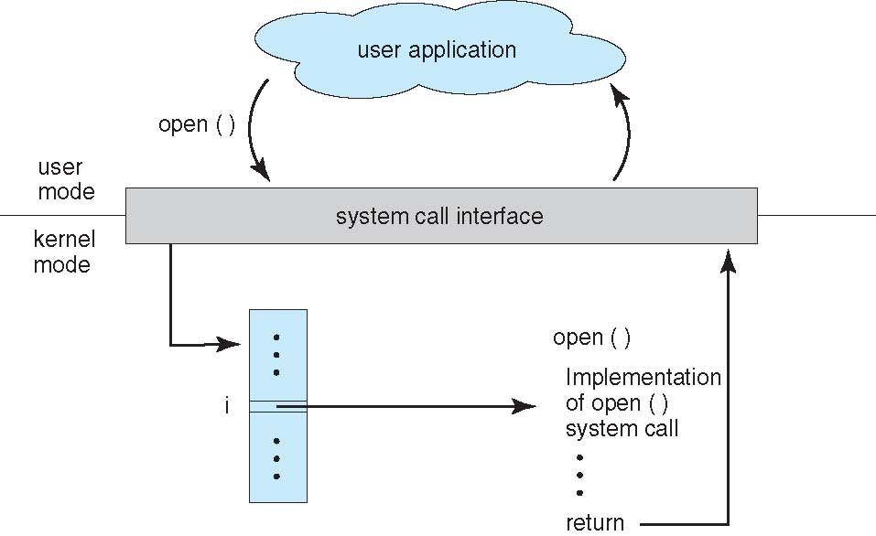
System Calls

Slide 37
Types of System Calls
Process control
create process, terminate process
end, abort
load, execute
get process attributes, set process attributes
File management
create file, delete file
open, close file
read, write file
get and set file attributes
Device management
request device, release device
read, write
get device attributes, set device attributes
logically attach or detach devices
Information Maintenance
Communication
Protection

Slide 38
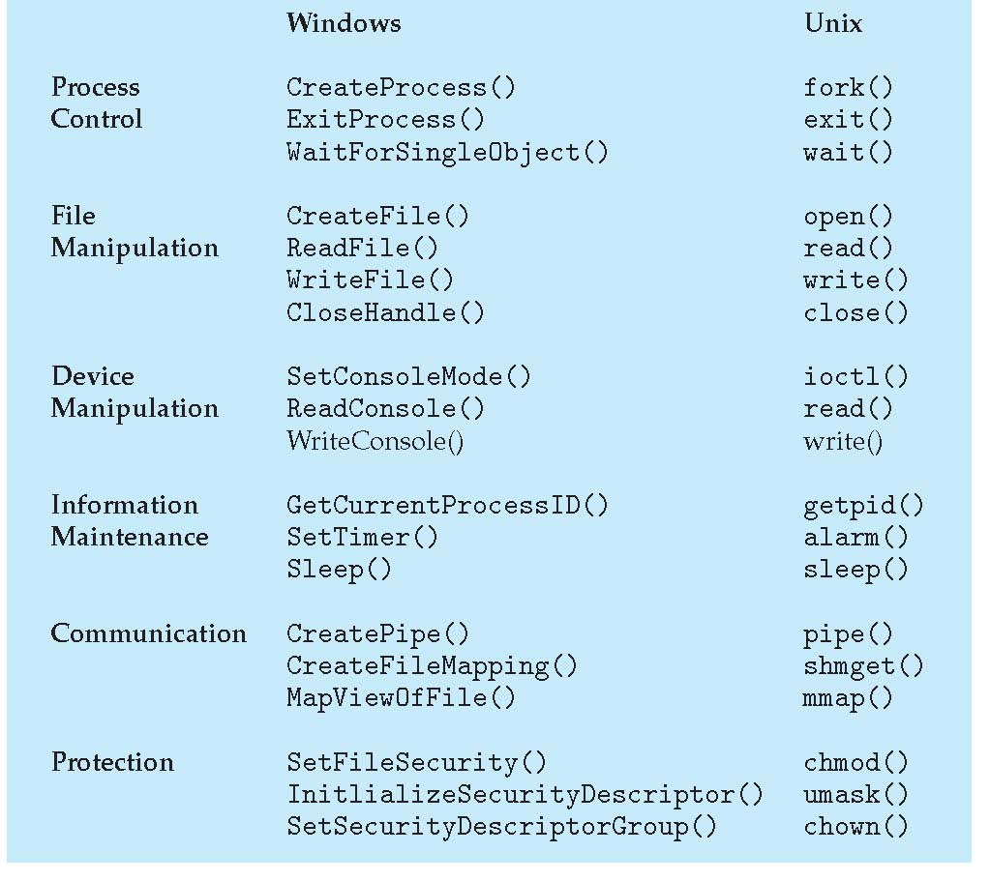
Examples of System Calls

Slide 39
OS Structure
Simple Structure/ Monolithic Kernel
Layered Approach
Microkernels
Modules
Hybrid System

Slide 40
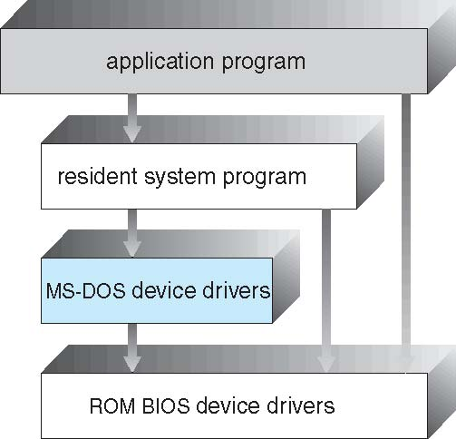
Simple Structure
not divided into modules
interfaces and levels of functionality are not well separated
application programs are able to access the basic I/O routines to write directly to the display and disk drives
vulnerable to malicious programs, causing entire system crashes when user programs fail

Slide 41
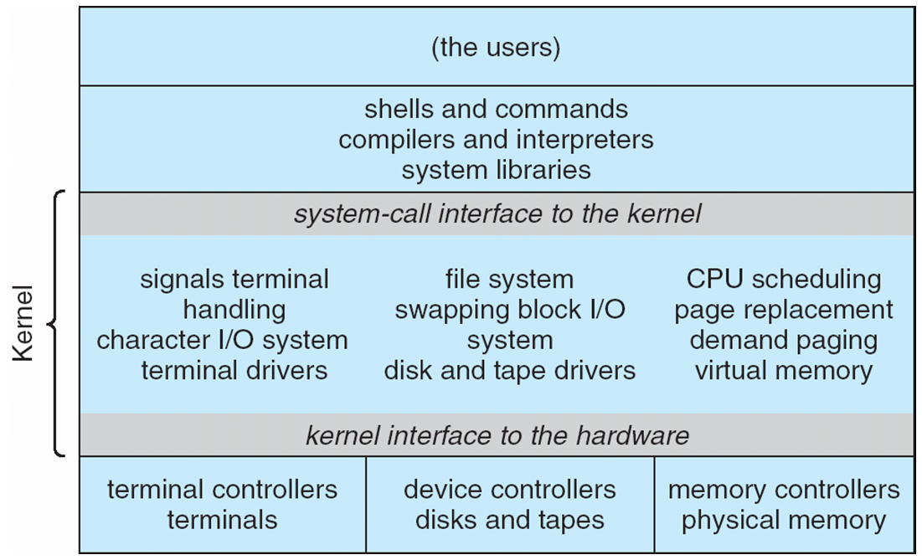
UNIX Architecture
the original UNIX operating system had limited structuring
consists of two separable parts
Systems programs
kernel
Consists of everything below the system-call interface and above the physical hardware
Provides the file system, CPU scheduling, memory management, and other operating-system functions; a large number of functions for one level

Slide 42
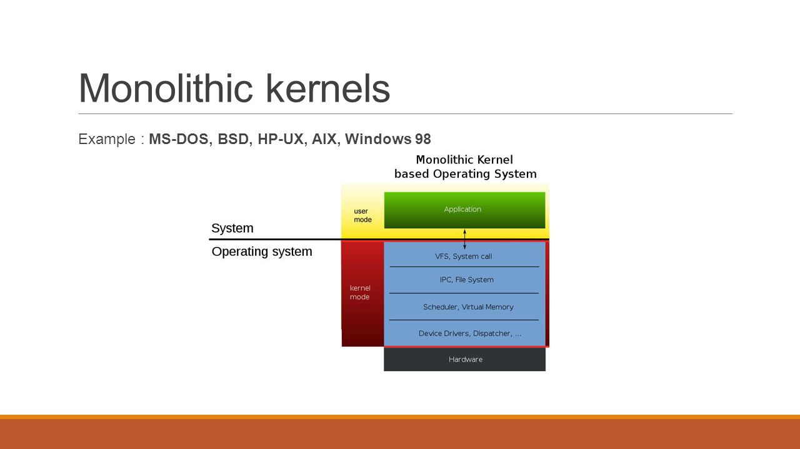
Monolithic Kernel
entire operating system is working in kernel space
larger in size
little overhead in system call interface or in communication within kernel
faster
hard to extend
if a service crashes, whole system is affected
Eg., - MS-DOS

Slide 43
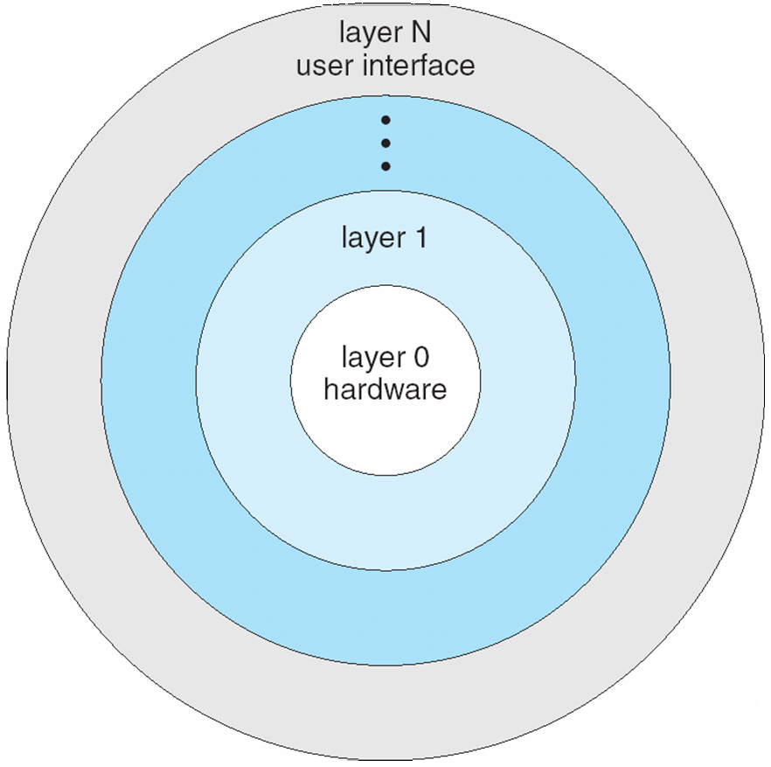
Layered Approach
The operating system is divided into a number of layers (levels), each built on top of lower layers
The bottom layer (layer 0), is the hardware; the highest (layer N) is the user interface
With modularity, layers are selected such that each uses functions (operations) and services of only lower-level layers

Slide 44
Microkernel
user services and kernel services are in separate address spaces
smaller in size
slower
extendible, all new services are added to user space
if a service crashes, working of microkernel is not affected
more secure and reliable
eg., Mach, QNX, Windows NT (initial release)
Drawback ???
Performance overhead of user space to kernel space communication

Slide 45
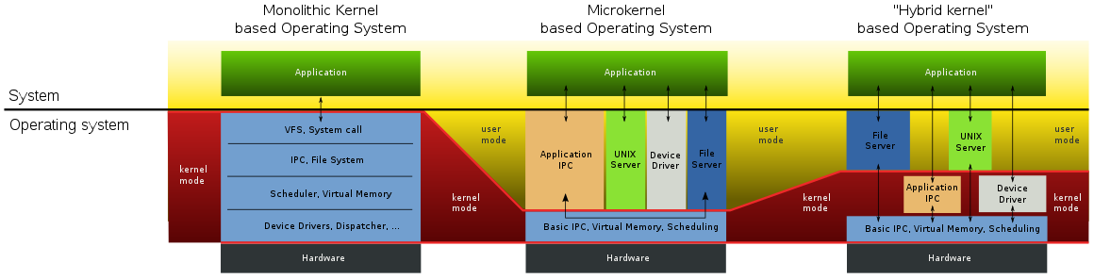
A Comparison
macOS X, Windows, iOS

Slide 46
Modules
loadable kernel modules
kernel has a core set of components
links in additional services via modules, either at boot time or during run time
each module has a well defined interface
dynamically linking services is preferable to adding new features directly to the kernel: does not require recompiling the kernel for every change
better than a layered approach: any module can call any module
better than microkernel: no message passing required to invoke modules

Slide 47
OPERATING SYSTEMS (CS F372) Processes

Slide 48
Process Concept
An operating system executes a variety of programs
Batch system – jobs
Time-shared systems – user programs or tasks
Terms job and process used interchangeably
Process – a program in execution; process execution must progress in sequential fashion

Slide 49
Process Concept
Multiple parts
The program code, also called text section
Current activity including program counter, processor registers
Stack containing temporary data
Function parameters, return addresses, local variables
Data section containing global variables
Heap containing memory dynamically allocated during run time

Slide 50
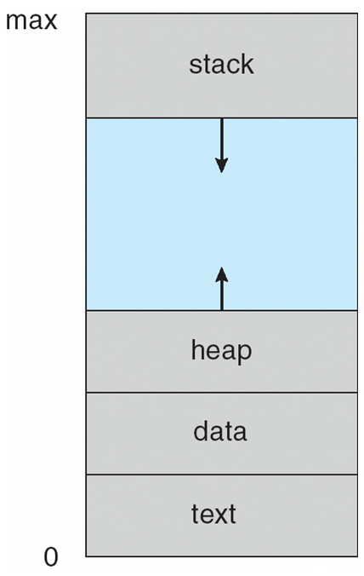
Process Concept
Program is passive entity stored on disk (executable file), process is active
Program becomes process when executable file loaded into memory
Execution of program started via GUI mouse clicks, command line entry of its name, etc
One program can be several processes
Consider multiple users executing the same program

Slide 51
States of Process
new: The process is being created
running: Instructions are being executed
waiting: The process is waiting for some event to occur
ready: The process is waiting to be assigned to a processor
terminated: The process has finished execution

Slide 52
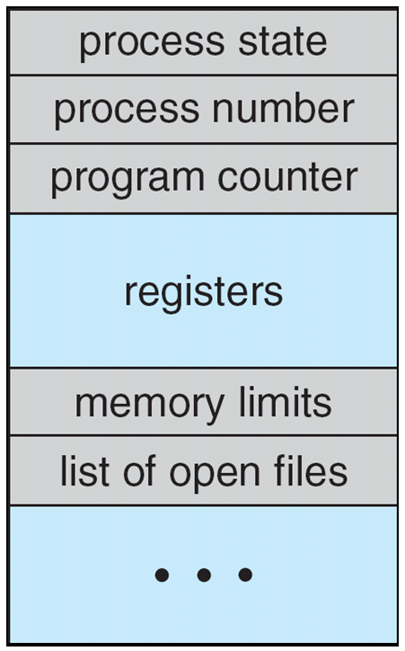
Process Control Block
Process state – new, ready, running, waiting, etc.
Program counter – location of instruction to next execute
CPU registers – contents of all process-centric registers
CPU scheduling information- priorities, scheduling queue pointers, scheduling parameters
Memory-management information – memory allocated to the process
Accounting information – CPU used, clock time elapsed since start, time limits, account nos., process nos.
I/O status information – I/O devices allocated to process, list of open files

Slide 53
Process Creation
Parent process create children processes, which, in turn create other processes, forming a tree of processes
Generally, process identified and managed via a process identifier (pid), integer number
Resource sharing options (CPU time, memory, files, I/O devices)
Parent and children share all resources
Children share subset of parent’s resources
Parent and child share no resources
Execution options
Parent and children execute concurrently
Parent waits until children terminate

Slide 54
Process Creation
Address space
Child duplicate of parent (same program and data)
Child has a program loaded into it
UNIX examples
fork() system call creates new process
exec() system call used after a fork() to replace the process’ memory space with a new program

Slide 55
Process Creation
fork()
address space of child process is a copy of parent process
both child and parent continue execution at the instruction after fork()
return code for fork() is 0 for child
return code for fork() is non-zero (child pid) for parent
exec()
loads a binary file into memory and starts execution
destroys previous memory image
call to exec() does not return unless an error occurs
wait()
parent can issue wait() to move out of ready queue until the child is done

Slide 56
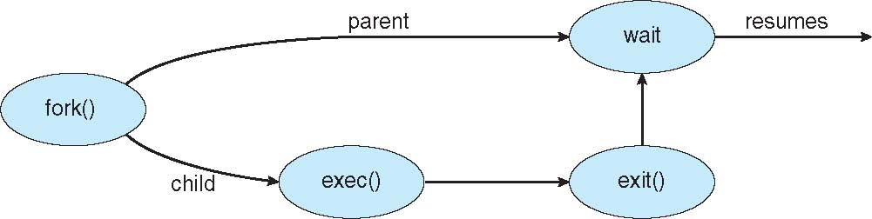
Process Creation
#include <sys/types.h>
#include <stdio.h>
#include <unistd.h>
int main()
{
pid_t pid;
pid = fork(); /* fork a child process */
if (pid < 0) { /* error occurred */
fprintf(stderr, "Fork Failed");
return 1;
}
else if (pid == 0) { /* child process */
printf("Child Process\n");
execlp("/bin/ls","ls",NULL);
}
else { /* parent process */
wait(NULL); /* parent waits for child to complete */
printf("Child Complete");
}
return 0;
}
OUTPUT:
Child Process
a.out Documents examples.desktop MyPrograms Pictures Templates
Desktop Downloads Music parent.c Public Videos
Child Complete

Slide 57
Process Creation
#include <sys/types.h>
#include <stdio.h>
#include <unistd.h>
int main()
{
pid_t pid; int x = 10;
pid = fork();
if (pid < 0) {
fprintf(stderr, "Fork Failed");
return 1;
}
else if (pid == 0) {
printf("Child Process: x = %d\n", x);
execlp("/bin/ls","ls",NULL);
}
else {
x++;
printf("Parent Process: x = %d\n", x);
wait(NULL);
printf("Child Complete");
}
return 0;
}
OUTPUT:
Parent Process: x = ?
Child Process: x = ?
a.out Documents examples.desktop MyPrograms Pictures Templates
Desktop Downloads Music parent.c Public Videos
Child Complete

Slide 58
Process Termination
Process executes last statement and then asks the operating system to delete it using the exit() system call.
May return status data from child to parent (via wait())
Process’ resources are deallocated by operating system
Parent may terminate the execution of children processes because:
Child has exceeded allocated resources limit
Task assigned to child is no longer required
Parent is exiting and the operating systems does not allow a child to continue if its parent terminates

Slide 59
Process Termination
Some operating systems do not allow child to exist if parent has terminated.
If a process terminates, then all its children must also be terminated.
cascading termination - All children, grandchildren, etc. are terminated.
The termination is initiated by the operating system.
The parent process may wait for termination of a child process by using the wait() system call. The call returns status information and the pid of the terminated process
pid_t pid;
int status;
pid = wait(&status); //parent can tell which child has terminated
If no parent waiting (did not invoke wait() till then) process is a zombie
If parent terminated, process is an orphan

Slide 60
Zombie Process
int main()
{
pid_t child_pid = fork();
if (child_pid > 0) {
sleep(10);
wait(NULL);
sleep(200);
}
else{
printf("\n%d",getpid());
exit(0);
}
return 0;
}
zombie
no longer a zombie

Slide 61
Orphan Process
int main()
{
pid_t child_pid = fork();
if (child_pid > 0){
printf("\nParent process: %d\n",getpid());
sleep(6);
}
else{
printf("\nParent PID: %d\n",getppid());
sleep(20);
printf("\nChild Process: %d",getpid());
printf("\nParent PID: %d",getppid());
exit(0);
}
return 0;
}

Slide 62
Interprocess Communication
Processes within a system may be independent or cooperating
Cooperating process can affect or be affected by other processes, including sharing data
Reasons for cooperating processes:
Information sharing
Computation speedup
Modularity
Convenience
Cooperating processes need interprocess communication (IPC)
Three models of IPC
Pipes
Shared memory
Message passing

Slide 63
Interprocess Communication
message passing shared memory

Slide 64
Pipe
Acts as a conduit allowing two processes to communicate
Issues:
Is communication unidirectional or bidirectional?
In the case of two-way communication, is it half or full-duplex?
Must there exist a relationship (i.e., parent-child) between the communicating processes?
Can the pipes be used over a network?
Ordinary pipes –
cannot be accessed from outside the process that created it
parent process creates a pipe and uses it to communicate with a child process that it created
Named pipes – can be accessed without a parent-child relationship

Slide 65
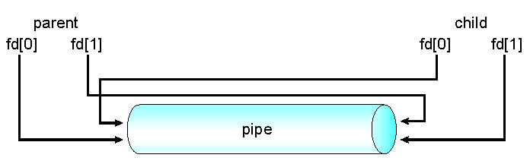
Ordinary Pipes allow communication in standard producer-consumer style
Producer writes to one end (the write-end of the pipe)
Consumer reads from the other end (the read-end of the pipe)
Ordinary pipes are unidirectional
Require parent-child relationship between communicating processes
Windows calls these anonymous pipes
Ordinary Pipe

Slide 66
Ordinary Pipe
ordinary pipe can’t be accessed from outside the process that created it
parent process creates a pipe and uses it to communicate with a child process that it creates via fork()
child inherits the pipe from its parent process like any other file

Slide 67
Named Pipe
Named Pipes are more powerful than ordinary pipes
Communication is bidirectional
No parent-child relationship is necessary between the communicating processes
Several processes can use the named pipe for communication
Do not cease to exist if the communicating processes have terminated
Provided on both UNIX and Windows systems
Referred to as FIFOs in UNIX systems

Slide 68
IPC – Shared Memory
An area of memory shared among the processes that wish to communicate
The communication is under the control of the users processes not the operating system
Provide mechanism that will allow the user processes to synchronize their actions when they access shared memory

Slide 69
IPC – Message Passing
Mechanism for processes to communicate and to synchronize their actions
Message system – processes communicate with each other without resorting to shared variables, no sharing of address space
IPC facility provides two operations:
send(message)
receive(message)
The message size is either fixed or variable
If processes P and Q wish to communicate, they need to:
Establish a communication link between them
Exchange messages via send() / receive()

Slide 70
Message Passing – Direct Communication
Processes must name each other explicitly:
send (P, message) – send a message to process P
receive(Q, message) – receive a message from process Q
Properties of communication link
Links are established automatically
Processes only need to know each other’s identity
A link is associated with exactly one pair of communicating processes
Between each pair there exists exactly one link

Slide 71
Message Passing – Indirect Communication
Messages are directed and received from mailboxes (also referred to as ports)
Each mailbox has a unique ID
Processes can communicate only if they share a mailbox
Properties of communication link
Link established only if processes share a common mailbox
A link may be associated with many processes
Each pair of processes may share several communication links, each link corresponds to one mailbox

Slide 72
Message Passing – Indirect Communication
Operations
create a new mailbox (port)
send and receive messages through mailbox
destroy a mailbox
Primitives are defined as:
send(A, message) – send a message to mailbox A
receive(A, message) – receive a message from mailbox A

Slide 73
Synchronization
Message passing may be either blocking or non-blocking
Blocking is considered synchronous
Blocking send -- the sender is blocked until the message is received by the receiving process or mailbox
Blocking receive -- the receiver is blocked until a message is available
Non-blocking is considered asynchronous
Non-blocking send -- the sender sends the message and continues
Non-blocking receive -- the receiver receives:
A valid message, or
Null message

Slide 74
Buffering
messages exchanged by communicating processes reside in a temporary queue
implemented in one of three ways
Zero capacity – no messages are queued, link can’t have any waiting messages, sender must block until receiver receives message
Bounded capacity – queue is of finite length of n messages, sender need not block if queue is not full, sender must wait if queue full
Unbounded capacity – infinite length queue, sender never blocks

Slide 75
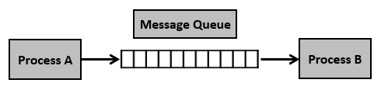
Message Queue
asynchronous communication
messages placed onto the queue are stored until the recipient retrieves them
Step 1 − Create a message queue or connect to an already existing message queue (msgget())
Step 2 − Write into message queue (msgsnd())
Step 3 − Read from the message queue (msgrcv())
Step 4 − Perform control operations on the message queue (msgctl())

Slide 76
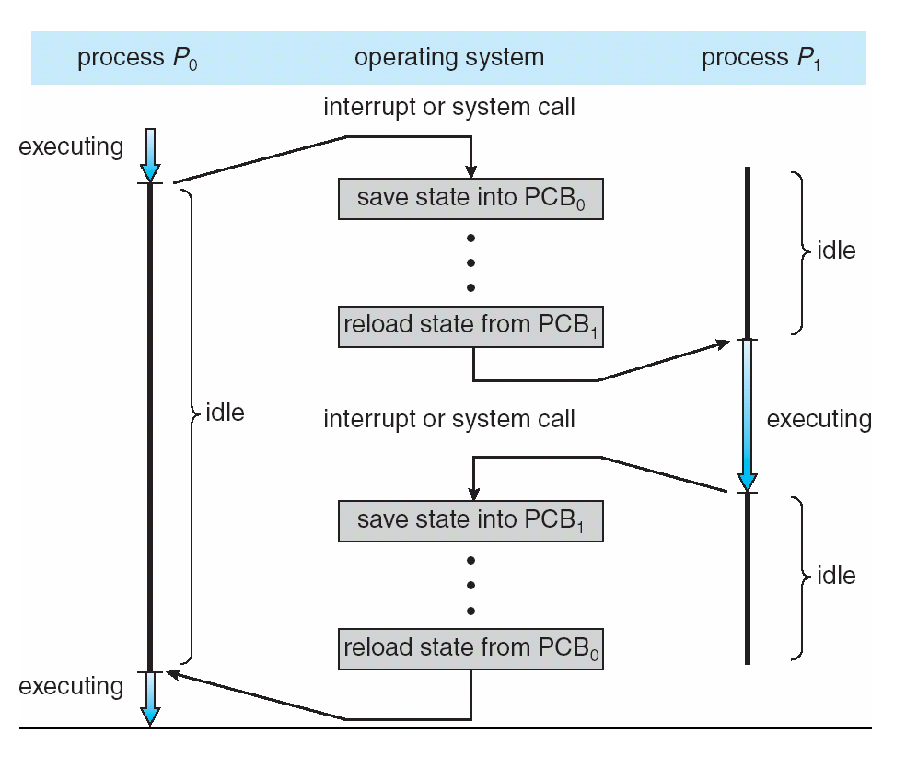
Context Switch
When CPU switches to another process, system must save state of the old process and load the state for the new process via a context switch
Context of a process represented in the PCB (CPU registers contents, process state, memory management info.)
Context-switch time is overhead; system does no useful work while switching
Time is dependent on hardware support

Slide 77
Process Scheduling
Maximize CPU use, quickly switch processes onto CPU for time sharing
Process scheduler selects among available processes for next execution on CPU
Maintains scheduling queues of processes
Job queue – set of all processes in the system
Ready queue – set of all processes residing in main memory, ready and waiting to execute, generally stored as a linked list
Device queues – set of processes waiting for an I/O device
Processes migrate among the various queues

Slide 78
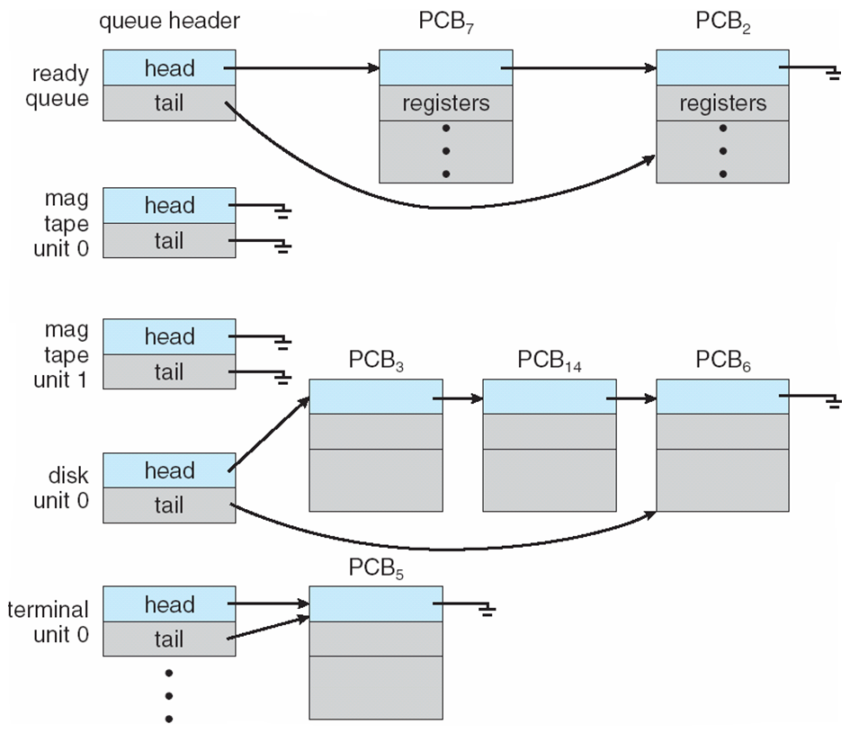
Various Queues

Slide 79
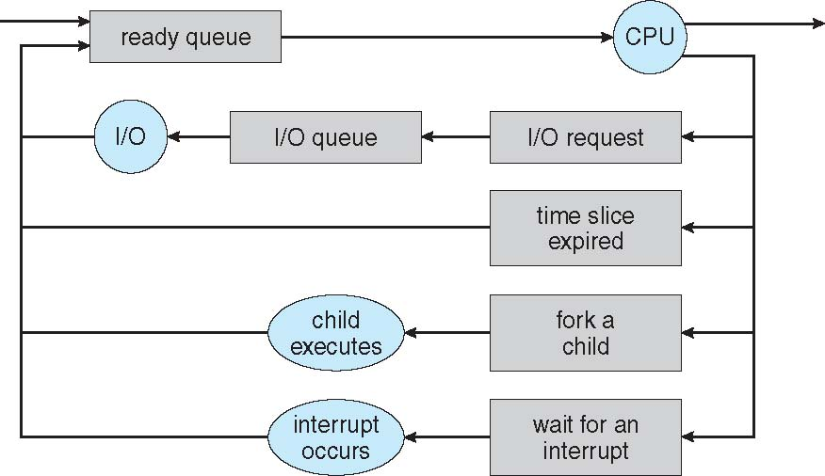
Process Scheduling
Queueing Diagram

Slide 80
Schedulers
Short-term scheduler (or CPU scheduler) – selects which process should be executed next and allocates CPU
Sometimes the only scheduler in a system
Short-term scheduler is invoked frequently (milliseconds) ⇒ (must be fast)
Long-term scheduler (or job scheduler) – selects which processes should be brought into the ready queue
Long-term scheduler is invoked infrequently (seconds, minutes) ⇒ (may be slow)
The long-term scheduler controls the degree of multiprogramming (number of processes in main memory)
Processes can be described as either:
I/O-bound process – spends more time doing I/O than computations, many short CPU bursts
CPU-bound process – spends more time doing computations; few very long CPU bursts
Long-term scheduler strives for good process mix

Slide 81
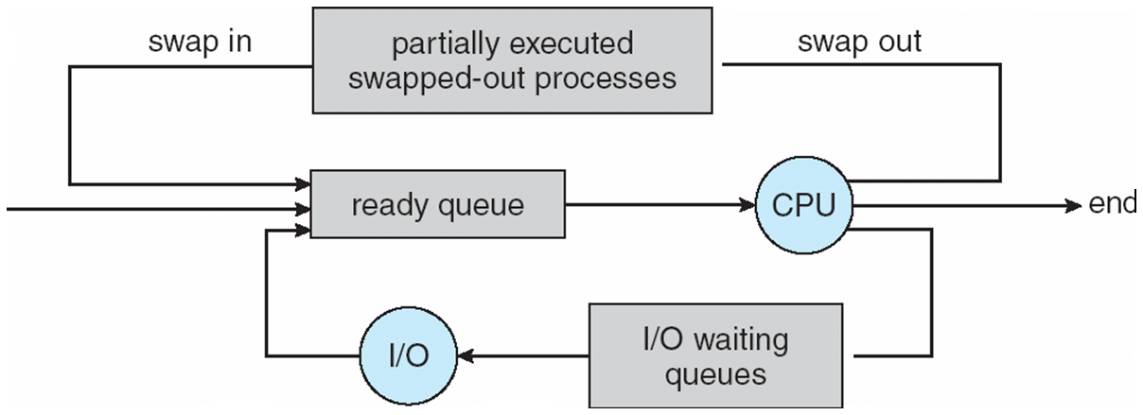
Schedulers
Medium-term scheduler can be added if degree of multiprogramming needs to decrease
Intermediate level of scheduling
Remove process from memory, store on disk, bring back in from disk to continue execution from where it left off: swapping
Required for improving process mix or for freeing of memory

Slide 82
OPERATING SYSTEMS (CS F372) Threads

Slide 83
Motivation
Most modern applications are multithreaded
Threads run within application
Multiple tasks with the application can be implemented by separate threads
Update display
Fetch data
Spell checking
Answer a network request
Process creation is heavy-weight while thread creation is light-weight
Can simplify code, increase efficiency

Slide 84
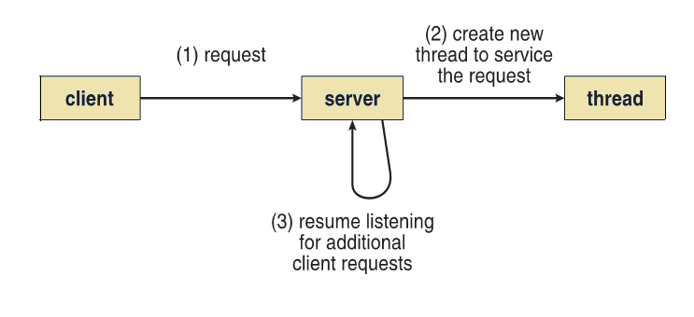
Motivation
Multithreaded Server Architecture

Slide 85
What is Thread?
Basic unit of CPU utilization
Comprises a thread ID, program counter, registers and stack
Shares with other threads belonging to the same program
code section
data section
OS resources like open files

Slide 86
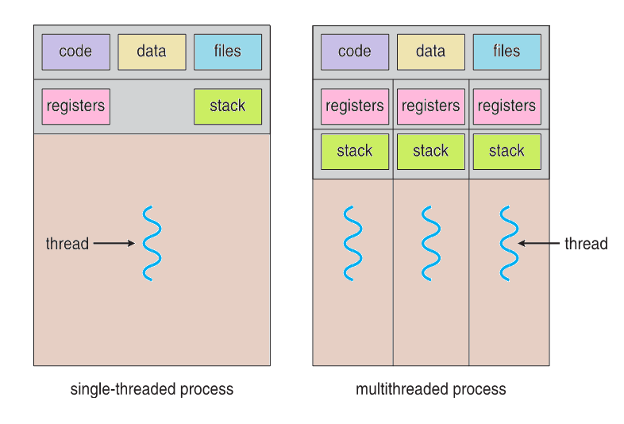
Motivation

Slide 87
Benefits
Responsiveness – may allow continued execution if part of process is blocked, especially important for user interfaces in interactive environments
Resource Sharing – threads share resources of process, easier than shared memory or message passing
Economy – cheaper than process creation, thread switching has lower overhead than context switching
Scalability – process can take advantage of multiprocessor architectures

Slide 88
Multicore Programming
Multicore or multiprocessor systems putting pressure on programmers, programming challenges include:
Identifying tasks
Balance
Data splitting
Data dependency
Testing and debugging
Parallelism implies a system can perform more than one task simultaneously
Concurrency supports more than one task making progress
Single processor / core, scheduler providing concurrency

Slide 89
Multicore Programming
Types of parallelism
Data parallelism – distributes subsets of the same data across multiple cores, same operation on each subset
Task parallelism – distributing tasks/threads across cores, each thread performing unique operation, threads may be operating on same or different data

Slide 90
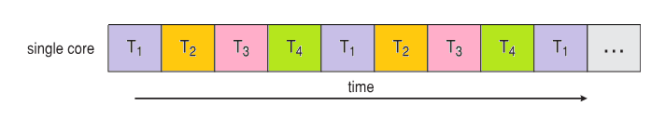
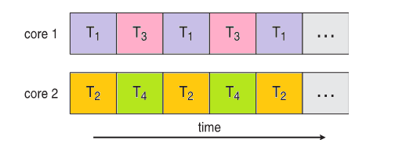
Concurrency vs Parallelism
Concurrent execution on single-core system:
Parallelism on a multi-core system:

Slide 91
User Threads and Kernel Threads
User threads - management done by user-level threads library without kernel support
Three primary thread libraries:
POSIX Pthreads
Windows threads
Java threads
Kernel threads - Supported and managed by the Kernel
Examples – virtually all general purpose operating systems support kernel threads, including:
Windows
Solaris
Linux
Tru64 UNIX
Mac OS X

Slide 92
Multithreading Models
Many-to-One
One-to-One
Many-to-Many

Slide 93
Many-to-One Model
Many user-level threads mapped to single kernel thread
Thread management done by thread library in user space
One thread blocking causes all to block
Multiple threads may not run in parallel on muticore system because only one can access kernel at a time
Few systems currently use this model
Examples:
Solaris Green Threads

Slide 94
One-to-One Model
Each user-level thread maps to kernel thread
Creating a user-level thread creates a kernel thread
More concurrency than many-to-one
Number of threads per process sometimes restricted due to overhead
Examples:
Windows
Linux
Solaris 9 and later

Slide 95
Many-to-Many Model
Allows many user level threads to be mapped to many kernel threads
Allows the operating system to create a sufficient number of kernel threads
Solaris prior to version 9
Windows with the ThreadFiber package

Slide 96
Two-Level Model
Similar to M:M, except that it allows a user thread to be bound to kernel thread
Examples
IRIX
HP-UX
Tru64 UNIX
Solaris 8 and earlier

Slide 97
Thread Libraries
Thread library provides programmer with API for creating and managing threads
Two primary ways of implementing
Library entirely in user space
Kernel-level library supported by the OS

Slide 98
Pthreads
May be provided either as user-level or kernel-level
A POSIX standard (IEEE 1003.1c) API for thread creation and synchronization
Specification, not implementation
API specifies behavior of the thread library, implementation is up to development of the library
Common in UNIX operating systems (Solaris, Linux, Mac OS X)

Slide 99
Pthreads Example
#include <pthread.h>
#include <stdio.h>
int sum; /* this data is shared by the thread(s) */
void *runner(void *param); /* threads call this function */
int main(int argc, char *argv[])
{
pthread_t tid; /* the thread identifier */
pthread_attr_t attr; /* set of thread attributes */
if (argc != 2) {
fprintf(stderr,"usage: a.out <integer value>\n");
return -1; }
if (atoi(argv[1]) < 0) {
fprintf(stderr,"%d must be >= 0\n",atoi(argv[1]));
return -1; }
pthread_attr_init(&attr); /* get the default attributes */
pthread_create(&tid, &attr, runner, argv[1]); /* create the thread */
pthread_join(tid, NULL); /* wait for the thread to exit */
printf("sum = %d\n", sum);
}
/* The thread will begin control in this function */
void *runner(void *param)
{
int i, upper = atoi(param);
sum = 0;
for (i = 1; i <= upper; i++)
sum += i;
pthread_exit(0);
}
synchronous threading

Slide 100
Pthreads Example
#define NUM THREADS 10
/* an array of threads to be joined upon */
pthread_t workers[NUM THREADS];
for (int i = 0; i < NUM THREADS; i++)
pthread join(workers[i], NULL);
JOINING 10 THREADS

Slide 101
Threading Issues
fork() and exec() system calls
Signal handling
Thread cancellation of target thread
Thread-local storage
Scheduler Activations

Slide 102
fork() and exec()
If one thread in a program calls fork(), does the new process duplicate all threads, or is the new process single-threaded?
Some UNIX systems have chosen to have two versions of fork(), one that duplicates all threads and another that duplicates only the thread that invoked the fork() system call
The exec() system call works in the same way
if a thread invokes the exec() system call, the program specified in the parameter to exec() will replace the entire process—including all threads
If exec() is called immediately after forking, then duplicating all threads is unnecessary, as the program specified in the parameters to exec() will replace the process
duplicating only the calling thread is appropriate
If the separate process does not call exec() after forking, the separate process should duplicate all threads

Slide 103
Signal Handling
Signals are used in UNIX systems to notify a process that a particular event has occurred
The signal is delivered to a process
When delivered, signal handler is used to process signals
Synchronous and asynchronous signals
Synchronous signals
illegal memory access, div. by 0
delivered to the same process that performed the operation generating the signal
Asynchronous signals
generated by an event external to a running process
the running process receives the signal asynchronously
Ctrl + C, timer expiration

Slide 104
Signal Handling
Signal is handled by one of two signal handlers:
default
user-defined
Every signal has default handler that kernel runs when handling signal
User-defined signal handler can override default signal handler
Some signals can be ignored, others are handled by terminating the process
For single-threaded, signal is delivered to process

Slide 105
Signal Handling
Where should a signal be delivered for multi-threaded process?
Deliver the signal to the thread to which the signal applies
Deliver the signal to every thread in the process
Deliver the signal to certain threads in the process
Assign a specific thread to receive all signals for the process
Method for delivering a signal depends on the type of signal generated
synchronous signals need to be delivered to the thread causing the signal and not to other threads in the process
some asynchronous signals—such as <Ctrl + C> should be sent to all threads
Signals can be delivered to a
specific process – specify process id and type of signal
specific thread – specify thread id and type of signal

Slide 106
Signal Handling
Most multithreaded versions of UNIX allow a thread to specify which signals it will accept and which it will block
In some cases, an asynchronous signal may be delivered only to those threads that are not blocking it
Signals need to be handled only once, a signal is delivered only to the first thread found that is not blocking it

Slide 107
Thread Cancellation
Terminating a thread before it has finished
Thread to be canceled is target thread
Two general approaches:
Asynchronous cancellation terminates the target thread immediately
Deferred cancellation allows the target thread to periodically check if it should be cancelled
What about freeing resources??
Pthread code to create and cancel a thread:
pthread_t tid;
/* create the thread */
pthread_create(&tid, &attr, worker, NULL);
. . .
/* cancel the thread */
pthread_cancel(tid);

Slide 108
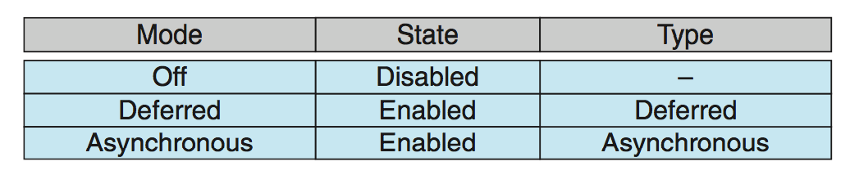
Thread Cancellation
Invoking thread cancellation requests cancellation, but actual cancellation depends on how the target thread is set up to handle the request
default type
If thread has cancellation disabled, cancellation remains pending until thread enables it
Default type is deferred
Cancellation only occurs when thread reaches cancellation point
Establish cancellation point by calling pthread_testcancel()
If cancellation request is pending, cleanup handler is invoked to release any acquired resources

Slide 109
Thread-Local Storage
Thread-local storage (TLS) allows each thread to have its own copy of data
Different from local variables
Local variables visible only during single function invocation
TLS visible across function invocations

Slide 110
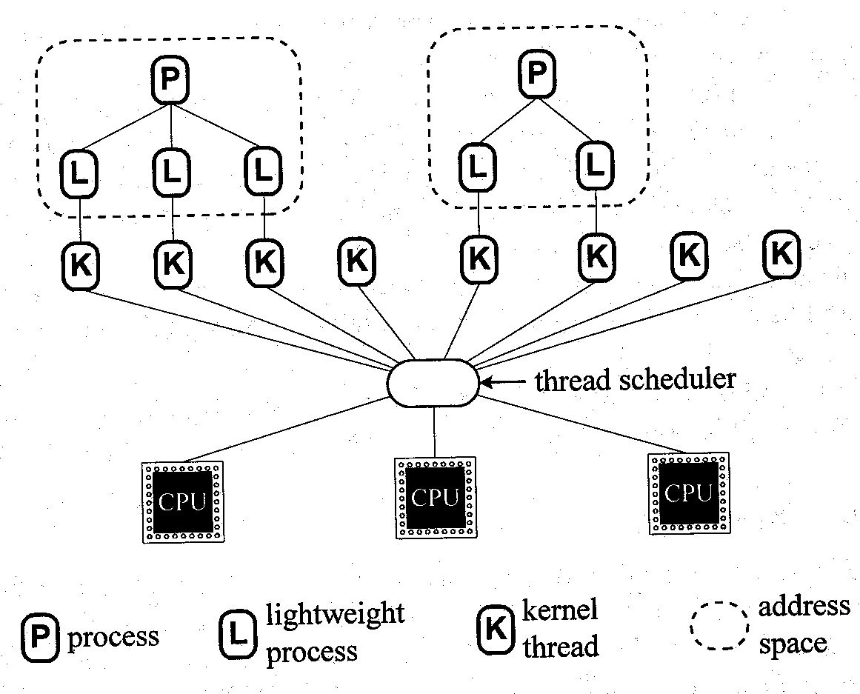
Scheduler Activations
Both M:M and Two-level models require communication to maintain appropriate number of kernel threads allocated to the application
Use an intermediate data structure between user and kernel threads – lightweight process (LWP)
Appears to be a virtual processor on which process can schedule user thread to run
Each LWP attached to kernel thread which is scheduled on a physical processor
How many LWPs to create?

Slide 111
Scheduler Activations
Scheduler activations - scheme for communication b/w user-thread library and kernel
Kernel provides an application with a set of virtual processors (LWPs)
Application can schedule user threads onto an available virtual processor
Kernel must inform an application about certain events via an upcall
Upcalls are handled by the thread library with an upcall handler
Upcall handlers must run on a virtual processor
Upcall trigerring occurs when an application thread is about to block

Slide 112
Kernel makes upcall to the application informing that a thread is about to block and identifying the thread
Kernel allocates a new virtual processor to the application
Application runs an upcall handler on this new virtual processor, which saves the state of the blocking thread and relinquishes the virtual processor on which the blocking thread is running
Upcall handler then schedules another thread that is eligible to run on an available virtual processor
When the event that the blocking thread was waiting for occurs, the kernel makes another upcall to the thread library informing it that the previously blocked thread is now eligible to run
Upcall handler for this event requires a virtual processor, and kernel may allocate a new virtual processor or preempt one of the user threads and run the upcall handler on its virtual processor
After marking the unblocked thread as eligible to run, the application schedules an eligible thread to run on an available virtual processor

Slide 113
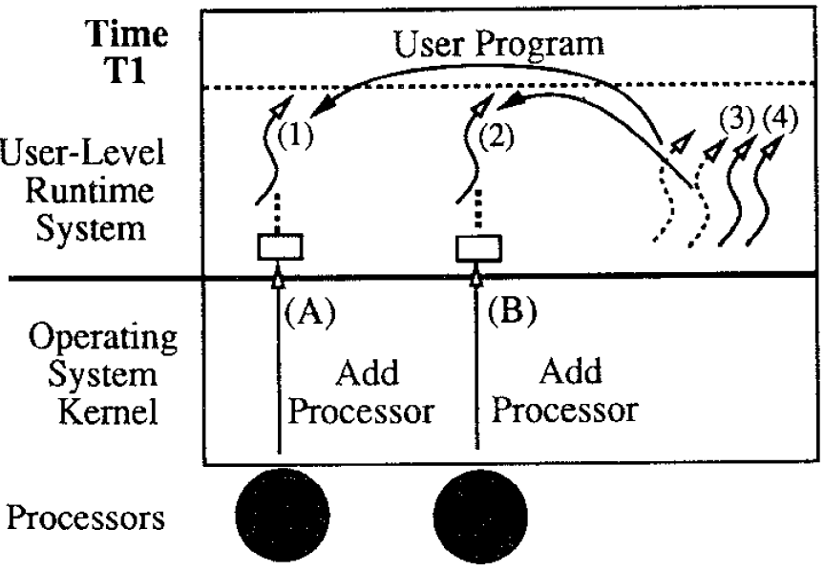
Scheduler Activations
At time T1, the kernel allocates the application two processors. On each processor, the kernel schedules a user-level thread taken from the ready list and starts execution.
Source: Scheduler Activations: Effective Kernel Support for the User-Level Management of Parallelism, THOMAS E. ANDERSON, BRIAN N. BERSHAD, EDWARD D. LAZOWSKA, and HENRY M. LEVY, 1992

Slide 114
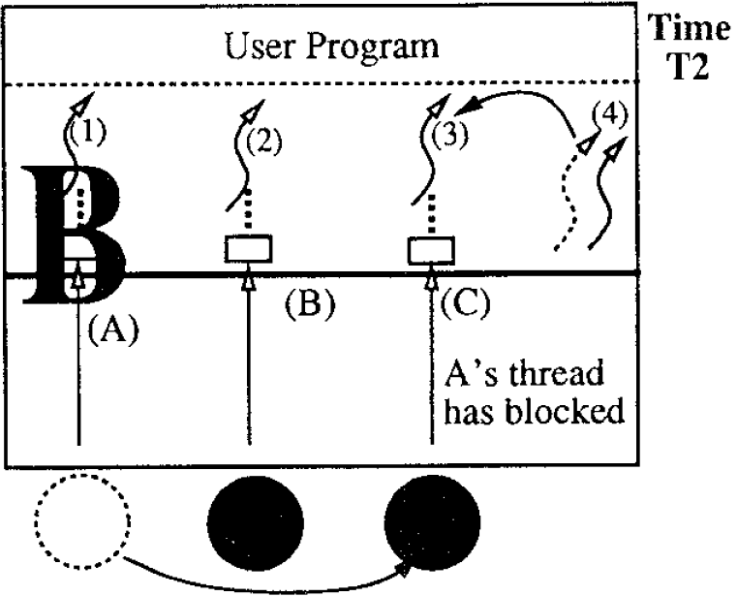
Scheduler Activations
At time T2, one of the user-level threads (thread 1) blocks in the kernel. To notify the user level of this event, the kernel takes the processor that had been running thread 1 and performs an upcall. The user-level thread scheduler can then use the processor to take another thread off the ready list and start running it.
Source: Scheduler Activations: Effective Kernel Support for the User-Level Management of Parallelism, THOMAS E. ANDERSON, BRIAN N. BERSHAD, EDWARD D. LAZOWSKA, and HENRY M. LEVY, 1992

Slide 115
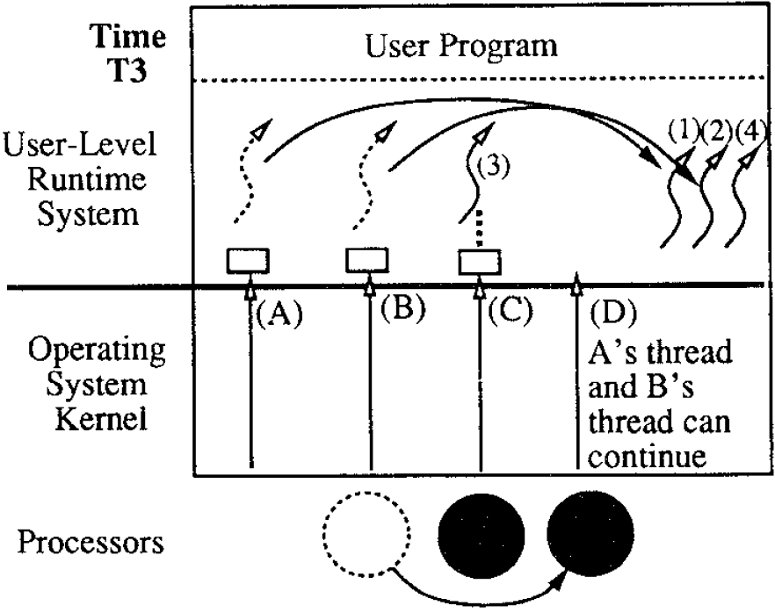
Scheduler Activations
At time T3, the I/O completes. Again, the kernel must notify the user-level thread system of the event, but this notification requires a processor. The kernel preempts one of the processors running and uses it to do the upcall. (If there are no processors available when the I/O completes, the upcall must wait until the kernel allocates one). The upcall puts the thread that had been blocked on the ready list and puts the thread that was preempted on the ready list.
Source: Scheduler Activations: Effective Kernel Support for the User-Level Management of Parallelism, THOMAS E. ANDERSON, BRIAN N. BERSHAD, EDWARD D. LAZOWSKA, and HENRY M. LEVY, 1992

Slide 116
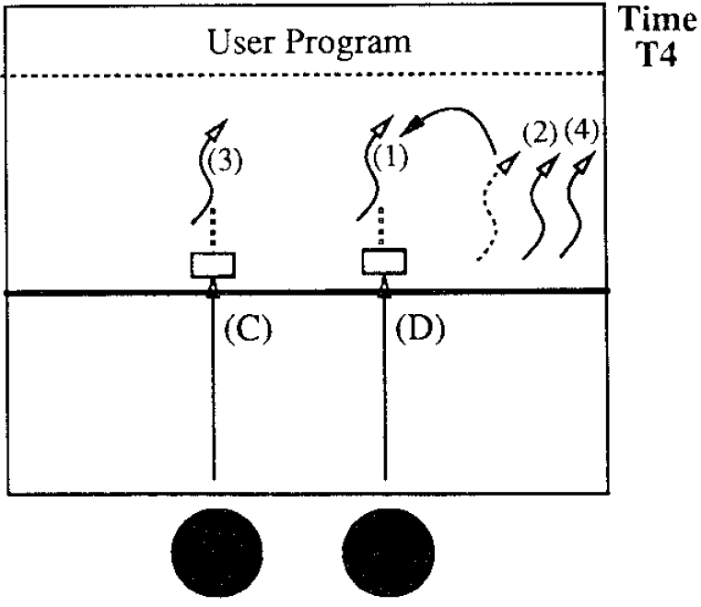
Scheduler Activations
Finally, at time T4, the upcall takes a thread off the ready list and starts running it.
Source: Scheduler Activations: Effective Kernel Support for the User-Level Management of Parallelism, THOMAS E. ANDERSON, BRIAN N. BERSHAD, EDWARD D. LAZOWSKA, and HENRY M. LEVY, 1992

Slide 117
Thank You

Slide 118
OPERATING SYSTEMS (CS F372) CPU Scheduling

Slide 119
Basics
Maximum CPU utilization obtained with multiprogramming
CPU–I/O Burst Cycle – Process execution consists of a cycle of CPU execution and I/O wait
CPU burst followed by I/O burst
More number of short CPU bursts and less number of long CPU bursts

Slide 120
CPU Scheduler
Short-term / CPU scheduler selects from among the processes in ready queue, and allocates the CPU to one of them
CPU scheduling decisions may take place when a process:
Switches from running to waiting state
Switches from running to ready state
Switches from waiting to ready
Terminates
Preemptive scheduling – done in situations 2 and 3
Nonpremptive /Cooperative scheduling – once a process is allocated the CPU it retains the CPU until termination or switching to waiting state

Slide 121
Dispatcher
Dispatcher module gives control of the CPU to the process selected by the short-term scheduler; this involves:
switching context
switching to user mode
jumping to the proper location in the user program to restart that program
Dispatch latency – time it takes for the dispatcher to stop one process and start another running

Slide 122
Scheduling Criteria
CPU utilization – keep the CPU as busy as possible
Throughput – no. of processes that complete their execution per time unit
Turnaround time – amount of time to execute a particular process, interval from submission time to completion time, sum of durations spent waiting to get into memory, waiting in ready queue, executing on CPU, doing I/O
Waiting time – amount of time a process has been waiting in the ready queue
Response time – amount of time it takes from when a request was submitted until the first response is produced, not output (for time-sharing environment), depends on the speed of output device

Slide 123
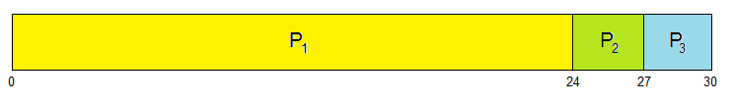
First- Come, First-Served (FCFS) Scheduling
Process Burst Time
P₁ 24
P₂ 3
P₃ 3
Suppose that the processes arrive in the order: P₁ , P₂ , P₃
Waiting time for P₁ = 0; P₂ = 24; P₃ = 27
Average waiting time: (0 + 24 + 27)/3 = 17

Slide 124
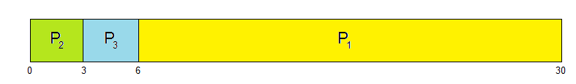
First- Come, First-Served (FCFS) Scheduling
Suppose that the processes arrive in the order:P₂ , P₃ , P₁
The Gantt chart for the schedule is:
Waiting time for P₁ = 6; P₂ = 0; P₃ = 3
Average waiting time: (6 + 0 + 3)/3 = 3
Much better than previous case
Convoy effect - short process behind long process
Consider one CPU-bound and many I/O-bound processes
Not applicable for time sharing systems

Slide 125
Shortest-Job-First (SJF) Scheduling
Associate with each process the length of its next CPU burst
Use these lengths to schedule the process with the shortest time
Use FCFS in case of tie
SJF is optimal – gives minimum average waiting time for a given set of processes
The difficulty is knowing the length of the next CPU request
For long-term (job) scheduling in a batch system, use the process time limit that a user specifies when the job is submitted

Slide 126
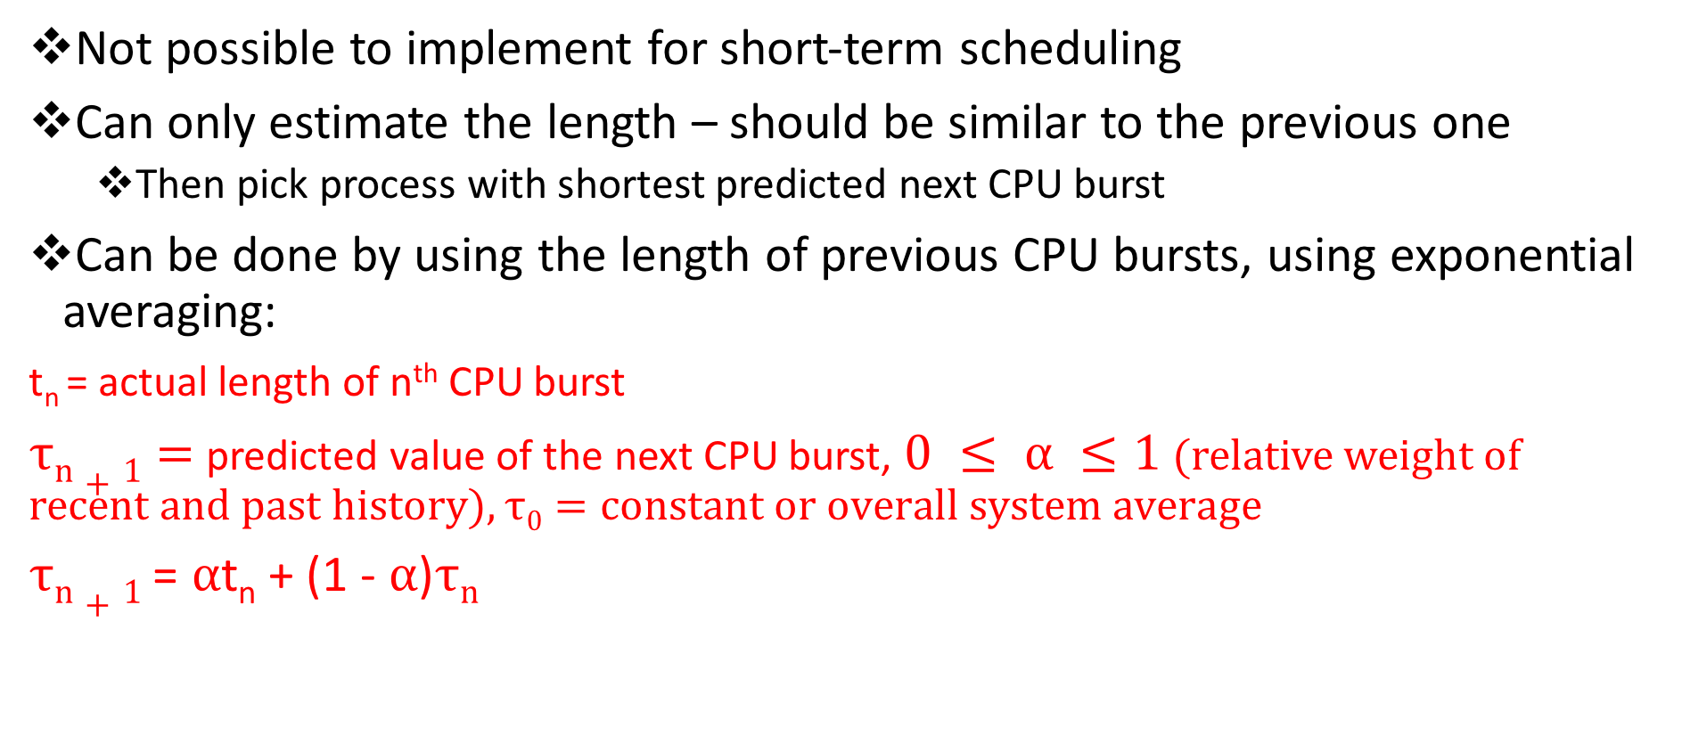
Determining Length of Next CPU Burst

Slide 127
Prediction of Length of Next CPU Burst
α =0
τ_{n+1} = τ_{n}
Recent history does not count
α =1
τ_{n+1} = α t_{n}
Only the actual last CPU burst counts
If we expand the formula, we get:
τ_{n+1} = α t_{n}+(1 - α)α t_{n} ₋₁ + … +(1 - α )^{j} α t_{n} _{-j} + … +(1 - α )^{n +1} τ₀
Since both α and (1 - α) are less than or equal to 1, each successive term has less weight than its predecessor
Commonly, α set to ½

Slide 128
Prediction of Length of Next CPU Burst
Can be nonpreemptive or preemptive
The next CPU burst of a newly arrived process may be shorter than what is left of the currently executing process
Preemptive version called shortest-remaining-time-first

Slide 129
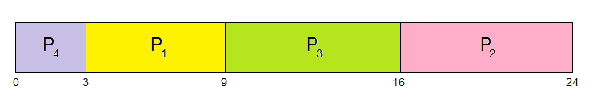
Shortest-Job-First (SJF) Scheduling
Process Burst Time
P₁ 0.0 6
P₂ 2.0 8
P₃ 4.0 7
P₄ 5.0 3
Average waiting time = (3 + 16 + 9 + 0) / 4 = 7 ms

Slide 130
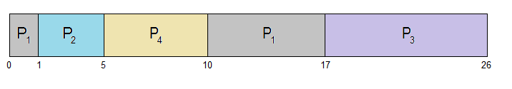
Shortest-remaining-time-first
ProcessA arri Arrival TimeT Burst Time
P₁ 0 8
P₂ 1 4
P₃ 2 9
P₄ 3 5
Preemptive SJF Gantt Chart
Average waiting time = [(10-1)+(1-1)+(17-2)+(5-3)]/4 = 26/4 = 6.5 msec

Slide 131
Priority Scheduling
A priority number (integer) is associated with each process, generally starting from 0
The CPU is allocated to the process with the highest priority (smallest integer ≡ highest priority)
Preemptive
Nonpreemptive
SJF is priority scheduling where priority is the inverse of predicted next CPU burst time
Problem ≡ Starvation – low priority processes may never execute
Solution ≡ Aging – as time progresses increase the priority of the process

Slide 132
Nonpreemptive Priority Scheduling
ProcessA arri Burst Time Priority
P₁ 10 3
P₂ 1 1
P₃ 2 4
P₄ 1 5
P₅ 5 2
Average waiting time = 8.2 msec
Problem: indefinite blocking and starvation.
Solutions: aging and pre-emptive priority scheduling

Slide 133
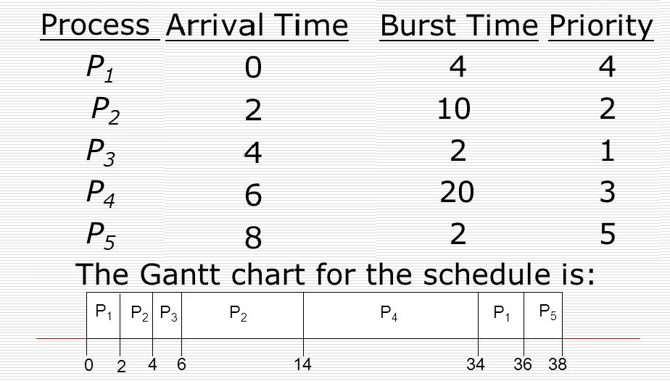
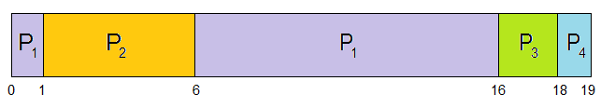
Preemptive Priority Scheduling

Slide 134
Round Robin (RR) Scheduling
Each process gets a small unit of CPU time (time quantum q), usually 10-100 milliseconds. After this time has elapsed, the process is preempted and added to the end of the ready queue.
If there are n processes in the ready queue and the time quantum is q, then each process gets 1/n of the CPU time in chunks of at most q time units at once. No process waits more than (n-1)q time units.
Timer interrupts every quantum to schedule next process
Performance
q large ⇒ FIFO
q small ⇒ q must be large with respect to context switch, otherwise overhead is too high

Slide 135
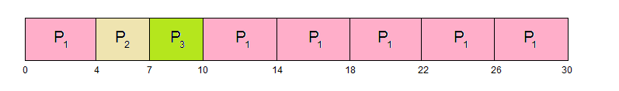
Round Robin (RR) Scheduling
Process Burst Time
P₁ 24 Here, q = 4
P₂ 3
P₃ 3
The Gantt chart is: Typically, higher average turnaround than SJF, but better response
q should be large compared to context switch time
q usually 10ms to 100ms, context switch < 10 usec

Slide 136
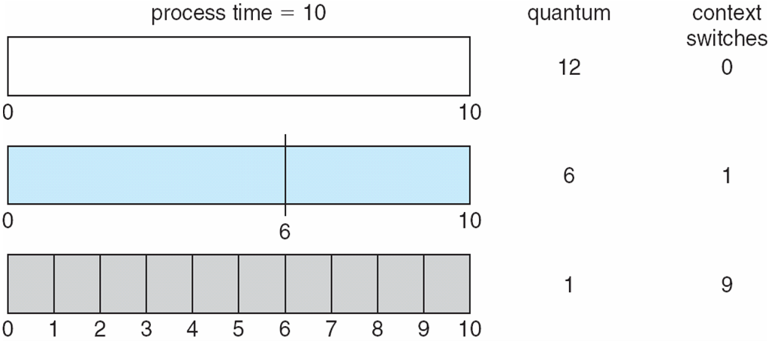
Time Quantum and Context Switch Time

Slide 137

Turnaround Time Varies With The Time Quantum
80% of CPU bursts should be shorter than q

Slide 138

Multilevel Queue Scheduling
fixed priority preemptive scheduling among queues

Slide 139
Multilevel Feedback Queue
A process can move between the various queues; aging can be implemented this way
Separate processes according to the characteristics of their CPU bursts
Multilevel-feedback-queue scheduler defined by the following parameters:
number of queues
scheduling algorithms for each queue
method used to determine when to upgrade a process
method used to determine when to demote a process
method used to determine which queue a process will enter when that process needs service

Slide 140

Multilevel Feedback Queue
Three queues:
Q₀ – RR with time quantum 8 milliseconds
Q₁ – RR time quantum 16 milliseconds
Q₂ – FCFS
Scheduling
A new process enters queue Q₀ which is uses RR
When it gains CPU, job receives 8 milliseconds
If it does not finish in 8 milliseconds, job is moved to queue Q₁
At Q₁ process is again served using RR and receives 16 additional milliseconds
If it still does not complete, it is preempted and moved to queue Q₂

Slide 141

CFS
Red-Black Tree
Every node has a color either red or black.
The root of the tree is always black.
There are no two adjacent red nodes (A red node cannot have a red parent or red child).
Every path from a node (including root) to any of its descendants NULL nodes has the same number of black nodes.
All leaf nodes are black nodes.
Self balancing: sub-trees are rotated when the properties are violated
Search, insert, delete: O(log n)

Slide 142

CFS

Slide 143
Thank You

Slide 144
OPERATING SYSTEMS (CS F372) Synchronization
Slides Courtesy: Dr. Barsha Mitra
Deptartment of CSIS, BITS Pilani, Hyderabad Campus

Slide 145
Background
Processes can execute concurrently
May be interrupted at any time, partially completing execution
Concurrent access to shared data may result in data inconsistency
Maintaining data consistency requires mechanisms to ensure the orderly execution of cooperating processes
Consider the Producer-Consumer problem

Slide 146
Producer - Consumer
while (true) { /* produce an item in next produced */
while (counter == BUFFER_SIZE) ;
/* do nothing */
buffer[in] = next_produced;
in = (in + 1) % BUFFER_SIZE;
counter++;
}
while (true) {
while (counter == 0)
; /* do nothing */
next_consumed = buffer[out];
out = (out + 1) % BUFFER_SIZE;
counter--;
/* consume the item in next consumed */
}

Slide 147
Race Condition
counter++ could be implemented as register1 = counter register1 = register1 + 1 counter = register1
counter-- could be implemented as register2 = counter register2 = register2 - 1 counter = register2
Consider this execution interleaving with counter = 5 initially:
S0 | producer execute register1 = counter | register1 = 5
S1 | producer execute register1 = register1 + 1 | register1 = 6
S2 | consumer execute register2 = counter | register2 = 5
S3 | consumer execute register2 = register2 – 1 | register2 = 4
S4 | producer execute counter = register1 | counter = 6
S5 | consumer execute counter = register2 | counter = 4

Slide 148

Critical Section Problem
Consider system of n processes {p₀ , p₁, … p_{n-1}}
Each process has critical section segment of code
Process may be changing common variables, updating table, writing file, etc.
When one process in critical section, no other may be in its critical section
Critical section problem is to design protocol to solve this
Each process must ask permission to enter critical section in entry section, may follow critical section with exit section, then remainder section

Slide 149
Requirements
1. Mutual Exclusion - If process P_{i} is executing in its critical section, then no other processes can be executing in their critical sections
2. Progress - If no process is executing in its critical section and some processes wish to enter their critical sections, then only those processes that are not executing in their remainder section can participate in deciding which will enter its critical section next, and this decision cannot be postponed indefinitely
3. Bounded Waiting - A bound must exist on the number of times that other processes are allowed to enter their critical sections after a process has made a request to enter its critical section and before that request is granted

Slide 150
Critical-Section Handling in OS
Two approaches depending on if kernel is preemptive or non-preemptive
Preemptive – allows preemption of process when running in kernel mode
Non-preemptive – runs until exits kernel mode, blocks, or voluntarily yields CPU
Essentially free of race conditions in kernel mode
Why then anyone would prefer preemptive kernel?????

Slide 151
Peterson’s Solution
Two process software based solution
Assume that the load and store machine-language instructions are atomic; that is, cannot be interrupted
The two processes share two variables:
int turn;
boolean flag[2];
The variable turn indicates whose turn it is to enter the critical section
The flag array is used to indicate if a process is ready to enter the critical section. flag[i] = true implies that process P_{i} is ready

Slide 152
Algorithm for Process P_{i}
do {
flag[i] = true;
turn = j;
while (flag[j] && turn = = j);
critical section
flag[i] = false;
remainder section
} while (true);
Provable that the 3 CS requirement are met:
1. Mutual exclusion is preserved
2. Progress requirement is satisfied
3. Bounded-waiting requirement is met

Slide 153
Check 3 Requirements
do {
flag[i] = true;
turn = j;
while (flag[j] && turn = = j);
critical section
flag[i] = false;
remainder section
} while (true);
P_{i}
do {
flag[j] = true;
turn = i;
while (flag[i] && turn = = i);
critical section
flag[j] = false;
remainder section
} while (true);
P_{j}

Slide 154
Synchronization Hardware
Many systems provide hardware support for implementing the critical section code
All solutions below based on idea of locking
Protecting critical regions via locks
Uniprocessors – could disable interrupts
Currently running code would execute without preemption
Generally too inefficient on multiprocessor systems
Modern machines provide special atomic hardware instructions
Atomic = non-interruptible
Either test memory word and set value
Or swap contents of two memory words

Slide 155
Solution to Critical-section Problem Using Locks
do {
acquire lock
critical section
release lock
remainder section
} while (TRUE);

Slide 156
test_and_set Instruction
boolean test_and_set (boolean *target)
{
boolean rv = *target;
*target = true;
return rv;
}
Executed atomically
Returns the original value of passed parameter
Sets the new value of passed parameter to true

Slide 157
Solution using test_and_set Instruction
Shared Boolean variable lock, initialized to false, supports mutual exclusion and progress but not bounded waiting
do { while (test_and_set(&lock))
; /* do nothing */
/* critical section */
lock = false;
/* remainder section */
} while (true);

Slide 158
compare_and_swap Instruction
int compare_and_swap(int *value, int expected, int new_value)
{
int temp = *value;
if (*value == expected)
*value = new_value;
return temp;
}
Executed atomically
Returns the original value of passed parameter value
Sets the variable value the value of the passed parameter new_value but only if value == expected. That is, the swap takes place only under this condition.

Slide 159
Solution using compare_and_swap
Shared (global) integer lock initialized to 0;
Solution:
do { while (compare_and_swap(&lock, 0, 1) != 0)
; /* do nothing */
/* critical section */
lock = 0;
/* remainder section */
} while (true);

Slide 160
Bounded-waiting Mutual Exclusion with test_and_set
common data structures – boolean waiting[n], boolean lock, initialized to false
do { waiting[i] = true; key = true; while (waiting[i] && key)
key = test_and_set(&lock);
waiting[i] = false;
/* critical section */
j = (i + 1) % n;
while ((j != i) && !waiting[j])
j = (j + 1) % n;
if (j == i)
lock = false;
else
waiting[j] = false;
/* remainder section */
} while (true);

Slide 161
Mutex Locks
Previous solutions are complicated and generally inaccessible to application programmers
OS designers build software tools to solve critical section problem
Simplest is mutex lock
Protect a critical section by first acquire() a lock then release() the lock
mutex lock has a boolean variable indicating if lock is available or not
Calls to acquire() and release() must be atomic
Usually implemented via hardware atomic instructions
But this solution requires busy waiting
This lock therefore called a spinlock

Slide 162
acquire() and release()
acquire() { while (!available)
; /* busy wait */
available = false;;
}
release() {
available = true;
}
do {
acquire lock
critical section
release lock
remainder section
} while (true);
Adv. of Spinlock:
In a multiprocessor system no context switch is required when a process must wait on a lock
useful when locks are to be held for short times
on a multiprocessor system, one thread can spin on one processor and the other may execute CS on another processor
Disadv. of Spinlock: busy waiting wastes CPU cycles

Slide 163
Semaphore
Provides more sophisticated ways (than mutex locks) for process to synchronize
Semaphore S – integer variable
Apart from initialization, can only be accessed via two indivisible (atomic) operations, wait() and signal(), Originally called P() and V()
Definition of the wait() operation
wait(S) {
while (S <= 0)
; // busy wait
S--;
}
Definition of the signal() operation
signal(S) {
S++;
}

Slide 164
Semaphore Usage
Counting semaphore – integer value can range over an unrestricted domain
Binary semaphore – integer value can range only between 0 and 1
Consider P₁ and P₂ that require S₁ to happen before S₂
Create a semaphore “synch” initialized to 0
P1:
S₁;
signal(synch);
P2:
wait(synch);
S₂;
Must guarantee that no two processes can execute the wait() and signal() on the same semaphore at the same time

Slide 165
Semaphore Implementation
With each semaphore there is an associated waiting queue
Each entry in a waiting queue has two data items:
value (of type integer)
pointer to next record in the list
Two operations:
block – place the process invoking the operation on the appropriate waiting queue
wakeup – remove one of processes in the waiting queue and place it in the ready queue
typedef struct{
int value;
struct process *list;
} semaphore;

Slide 166
Semaphore Implementation
wait(semaphore *S) {
S->value--;
if(S->value < 0){
add this process to S->list;
block();
}
}
signal(semaphore *S) {
S->value++;
if(S->value <= 0){ remove a process P from S->list;
wakeup(P);
}
}

Slide 167
Deadlock and Starvation
Deadlock – two or more processes are waiting indefinitely for an event that can be caused by only one of the waiting processes
Let S and Q be two semaphores initialized to 1
P₀ P₁
wait(S); wait(Q);
wait(Q); wait(S);
... ...
signal(S); signal(Q);
signal(Q); signal(S);
Starvation – indefinite blocking , A process may never be removed from the semaphore queue in which it is suspended
Priority Inversion – Scheduling problem when lower-priority process holds a lock needed by higher-priority process, Solved via priority-inheritance protocol

Slide 168
Classical Problems of Synchronization
Classical problems used to test newly-proposed synchronization schemes
Bounded-Buffer Problem
Readers and Writers Problem
Dining-Philosophers Problem

Slide 169
Bounded-Buffer Problem
n buffers, each can hold one item (int n)
Semaphore mutex initialized to the value 1
Semaphore full initialized to the value 0
Semaphore empty initialized to the value n

Slide 170
Bounded-Buffer Problem
Structure of the producer process
do {
... /* produce item in next_produced */
...
wait(empty);
wait(mutex);
... /* add next_produced to the buffer */
...
signal(mutex);
signal(full);
} while (true);
Structure of the consumer process
do {
wait(full);
wait(mutex);
... /*remove item from buffer to next_consumed*/
...
signal(mutex);
signal(empty);
... /*consume the item in next_consumed */
...
} while (true);

Slide 171
Readers-Writers Problem
A data set is shared among a number of concurrent processes
Readers – only read the data set; they do not perform any updates
Writers – can both read and write
Problem – allow multiple readers to read at the same time
Only one single writer can access the shared data at the same time
Several variations of how readers and writers are considered – all involve some form of priorities
First readers-writers prob. no reader is kept waiting unless a writer has already obtained the permission to use the shared obj., writers may starve
Second readers-writers prob. if a writer is waiting to access the shared obj. no new readers may start, readers may starve

Slide 172
Readers-Writers Problem
Shared Data
Semaphore rw_mutex initialized to 1, common to both readers and writers, acts as a mutual exclusion semaphore for writers, used by first reader that enters CS or last reader that exits CS, not used by other readers
Integer read_count initialized to 0, keeps track of how many processes are reading the shared obj.
Semaphore mutex initialized to 1, ensures mutual exclusion when read_count is updated

Slide 173
Readers-Writers Problem
Structure of a writer process
do { wait(rw_mutex);
... /* writing is performed */
...
signal(rw_mutex);
} while (true);
Structure of a reader process
do { wait(mutex); read_count++; if (read_count == 1) wait(rw_mutex);
signal(mutex);
... /* reading is performed */
...
wait(mutex); read count--; if (read_count == 0) signal(rw_mutex);
signal(mutex);
} while (true);

Slide 174

Dining-Philosophers Problem
Philosophers spend their lives alternating thinking and eating
Don’t interact with their neighbors, occasionally try to pick up 2 chopsticks (one at a time) to eat from bowl
Can pickup only one chopstick at a time
Need both to eat, then release both when done
In the case of 5 philosophers
Shared data
Bowl of rice (data set)
Semaphore chopstick [5] initialized to 1

Slide 175
Dining-Philosophers Problem Algorithm
Structure of Philosopher i:
do {
wait (chopstick[i] );
wait (chopstick[ (i + 1) % 5] );
// eat
signal (chopstick[i] );
signal (chopstick[ (i + 1) % 5] );
// think
} while (TRUE);
What is the problem with this algorithm?

Slide 176
Dining-Philosophers Problem Algorithm
Deadlock handling
Allow at most 4 philosophers to be sitting simultaneously at the table.
Allow a philosopher to pick up the chopsticks only if both are available (picking must be done in a critical section.
Use an asymmetric solution -- an odd-numbered philosopher picks up first the left chopstick and then the right chopstick. Even-numbered philosopher picks up first the right chopstick and then the left chopstick.

Slide 177
Problems with Semaphores
Incorrect use of semaphore operations:
signal (mutex) …. wait (mutex)
wait (mutex) … wait (mutex)
Omitting of wait (mutex) or signal (mutex) (or both)
Deadlock and starvation are possible.

Slide 178
OPERATING SYSTEMS (CS F372) Deadlocks

Slide 179
System Model
System consists of resources
Resource types R₁, R₂, . . ., R_{m}
Each resource type R_{i} has W_{i} instances.
Each process utilizes a resource as follows:
request
use
release

Slide 180
Necessary Conditions
Deadlock can arise if four conditions hold simultaneously
Mutual exclusion: only one process at a time can use a resource
Hold and wait: a process holding at least one resource is waiting to acquire additional resources held by other processes
No preemption: a resource can be released only voluntarily by the process holding it, after that process has completed its task
Circular wait: there exists a set {P₀, P₁, …, P_{n}} of waiting processes such that P₀ is waiting for a resource that is held by P₁, P₁ is waiting for a resource that is held by P₂, …, P_{n–1} is waiting for a resource that is held by P_{n}, and P_{n} is waiting for a resource that is held by P₀.

Slide 181

Resource-Allocation Graph
A set of vertices V and a set of edges E
V is partitioned into two types:
P = {P₁, P₂, …, P_{n}}, the set consisting of all the processes in the system
R = {R₁, R₂, …, R_{m}}, the set consisting of all resource types in the system
request edge – directed edge P_{i} → R_{j}
assignment edge – directed edge R_{j} → P_{i}

Slide 182


Examples

Slide 183
Inferring Deadlock
If graph contains no cycles: no deadlock
If graph contains a cycle:
if only one instance per resource type, then deadlock
if several instances per resource type, possibility of deadlock

Slide 184
Deadlock Handling
Ensure that the system will never enter a deadlock state:
Deadlock prevention
Deadlock avoidance
Allow the system to enter a deadlock state and then recover
Ignore the problem and pretend that deadlocks never occur in the system; used by most operating systems, including UNIX, application programmers should ensure that deadlocks don’t occur

Slide 185
Deadlock Prevention
Mutual Exclusion – not required for sharable resources (e.g., read-only files); must hold for non-sharable resources
Hold and Wait – must guarantee that whenever a process requests a resource, it does not hold any other resources
Require process to request and be allocated all its resources before it begins execution, or allow process to request resources only when the process has none allocated to it
Low resource utilization; starvation possible

Slide 186
Deadlock Prevention
No Preemption –
If a process that is holding some resources requests another resource that cannot be immediately allocated to it, then all resources currently being held are released
Preempted resources are added to the list of resources for which the process is waiting
Process will be restarted only when it can regain its old resources, as well as the new ones that it is requesting
When a process P₁ requests some resources and they are allocated to some other waiting process P₂, then preempt the desired resources from P₂ and give them to P₁
If the resources are not allocated to a waiting process, then P₁ must wait
While waiting P₁’s resources may be preempted

Slide 187
Deadlock Prevention
Circular Wait – impose a total ordering of all resource types, and require that each process requests resources in an increasing order of enumeration
define a 1:1 function F : R → N (N is set of natural nos.)
Say a process P has requested a no. of instances of R_{i}
Later, P_{i} can request resources of type R_{j} iff F(R_{j}) > F(R_{i})
Alternatively, if P_{i} requests an instance of R_{j} then P_{i} must have released all instances of R_{i} s.t. F(R_{i}) >= F(R_{j})
Several instances of same resource type must be requested for in a single request
Proof by contradiction

Slide 188
Deadlock Avoidance
Requires that the system has some additional a priori information available
Requires that each process declare the maximum number of resources of each type that it may need
Resource-allocation state is defined by the number of available and allocated resources, and the maximum demands of the processes
Deadlock-avoidance algorithm dynamically examines the resource-allocation state to ensure that there can never be a circular-wait condition

Slide 189
Safe State
When a process requests an available resource, system must decide if immediate allocation leaves the system in a safe state
System is in safe state if there exists a sequence <P₁, P₂, …, P_{n}> of ALL the processes in the systems such that for each P_{i}, the resources that P_{i} can still request can be satisfied by currently available resources + resources held by all the P_{j}, with j < i
That is:
If resources needed by P_{i} are not immediately available, then P_{i} can wait until all P_{j} have finished
When P_{j} is finished, P_{i} can obtain needed resources, execute, return allocated resources, and terminate
When P_{i} terminates, P_{i +1} can obtain its needed resources, and so on

Slide 190

Inferences
If a system is in safe state: no deadlocks
If a system is in unsafe state: possibility of deadlock
Avoidance: ensure that a system will never enter an unsafe state

Slide 191
Avoidance Algorithms
Single instance of a resource type
Use a resource-allocation graph
Multiple instances of a resource type
Use the banker’s algorithm

Slide 192


Resource-Allocation-Graph Algorithm
Claim edge P_{i} → R_{j} indicated that process P_{i} may request resource R_{j} in future; represented by a dashed line
Claim edge converts to request edge when a process requests a resource
Request edge converted to an assignment edge when the resource is allocated to the process
When a resource is released by a process, assignment edge reconverts to a claim edge
Resources must be claimed a priori in the system
Suppose that process P_{i} requests a resource R_{j}
The request can be granted only if converting the request edge to an assignment edge does not result in the formation of a cycle in the resource allocation graph

Slide 193
Banker’s Algorithm
Multiple instances of a resource type
Each process must a priori declare maximum use
When a process requests a resource it may have to wait
When a process gets all its resources it must return them in a finite amount of time

Slide 194
Data Structures for Banker’s Algorithm
n = number of processes, and m = number of resources types
Available: Vector of length m. If Available [j] = k, there are k instances of resource type R_{j} are available
Max: n x m matrix. If Max [i][j] = k, then process P_{i} may request at most k instances of resource type R_{j}
Allocation: n x m matrix. If Allocation[i][j] = k then P_{i} is currently allocated k instances of R_{j}
Need: n x m matrix. If Need[i][j] = k, then P_{i} may need k more instances of R_{j} to complete its task Need [i][j] = Max[i][j] – Allocation [i][j]
Each row of Max, Allocation and Need can be treated as vectors
If X and Y are 2 vectors, then X <= Y iff, X[i] <= Y[i] for all i = 1, 2, ...., m
X < Y, if X<=Y and X ≠ Y

Slide 195
Safety Algorithm
1. Let Work and Finish be vectors of length m and n, respectively.
Initialize: Work = Available, Finish [i] = false for i = 0, 1, …, n – 1
2. Find an i such that both:
(a) Finish [i] == false
(b) Need_{i} <= Work
If no such i exists, go to step 4
3. Work = Work + Allocation_{i} Finish[i] = true go to step 2
4. If Finish [i] == true for all i, then the system is in a safe state
O(mn²) operations

Slide 196
Banker’s Algorithm Example
5 processes P₀ through P₄;
3 resource types: A (10 instances), B (5instances), and C (7 instances)
Snapshot at time T₀:
The system is in a safe state since the sequence < P₁, P₃, P₄, P₂, P₀> satisfies safety criteria
Process | Allocation |  |  | Max |  |  | Available
 | A | B | C | A | B | C | A | B | C
P₀ | 0 | 1 | 0 | 7 | 5 | 3 | 3 | 3 | 2
P₁ | 2 | 0 | 0 | 3 | 2 | 2
P₂ | 3 | 0 | 2 | 9 | 0 | 2
P₃ | 2 | 1 | 1 | 2 | 2 | 2
P₄ | 0 | 0 | 2 | 4 | 3 | 3
Process
P₀
P₁
P₂
P₃
P₄
Need
A | B | C
7 | 4 | 3
1 | 2 | 2
6 | 0 | 0
0 | 1 | 1
4 | 3 | 1

Slide 197
Resource-Request Algorithm
Request_{i} = request vector for process P_{i}. If Request_{i} [j] = k then process P_{i} wants k instances of resource type R_{j}
1. If Request_{i} <= Need_{i} go to step 2. Otherwise, raise error condition, since process has exceeded its maximum claim
2. If Request_{i} <= Available, go to step 3. Otherwise P_{i} must wait, since resources are not available
3. Pretend to allocate requested resources to P_{i} by modifying the state as follows:
Available = Available – Request_{i} ;
Allocation_{i} = Allocation_{i} + Request_{i};
Need_{i} = Need_{i} – Request_{i} ;
If safe: the resources are allocated to P_{i}
If unsafe: P_{i} must wait, and the old resource-allocation state is restored

Slide 198
Banker’s Algorithm Example:
P₁ Requests (1,0,2)
Check that Request <= Available (that is, (1,0,2) <= (3,3,2): true
Executing safety algorithm shows that sequence < P₁, P₃, P₄, P₀, P₂> satisfies safety requirement
Can request for (3,3,0) by P₄ be granted?
Can request for (0,2,0) by P₀ be granted?
Process | Allocation |  |  | Max |  |  | Available
 | A | B | C | A | B | C | A | B | C
P₀ | 0 | 1 | 0 | 7 | 5 | 3 | 2 | 3 | 0
P₁ | 3 | 0 | 2 | 3 | 2 | 2
P₂ | 3 | 0 | 2 | 9 | 0 | 2
P₃ | 2 | 1 | 1 | 2 | 2 | 2
P₄ | 0 | 0 | 2 | 4 | 3 | 3
Process
P₀
P₁
P₂
P₃
P₄
Need
A | B | C
7 | 4 | 3
0 | 2 | 0
6 | 0 | 0
0 | 1 | 1
4 | 3 | 1

Slide 199
Banker’s Algorithm Example:
P₁ Requests (1,0,2)
Check that Request <= Available (that is, (1,0,2) <= (3,3,2): true
Executing safety algorithm shows that sequence < P₁, P₃, P₄, P₀, P₂> satisfies safety requirement
Can request for (3,3,0) by P₄ be granted? NO: resources unavailable
Can request for (0,2,0) by P₀ be granted? NO: results in unsafe state
Process | Allocation |  |  | Max |  |  | Available
 | A | B | C | A | B | C | A | B | C
P₀ | 0 | 1 | 0 | 7 | 5 | 3 | 2 | 3 | 0
P₁ | 3 | 0 | 2 | 3 | 2 | 2
P₂ | 3 | 0 | 2 | 9 | 0 | 2
P₃ | 2 | 1 | 1 | 2 | 2 | 2
P₄ | 0 | 0 | 2 | 4 | 3 | 3
Process
P₀
P₁
P₂
P₃
P₄
Need
A | B | C
7 | 4 | 3
0 | 2 | 0
6 | 0 | 0
0 | 1 | 1
4 | 3 | 1

Slide 200
Deadlock Detection
Allow system to enter deadlock state
Detection algorithm
Recovery scheme

Slide 201

Single Instance of Each Resource Type
Maintain wait-for graph
Nodes are processes
P_{i} → P_{j} if P_{i} is waiting for P_{j}
Periodically invoke an algorithm that searches for a cycle in the graph. If there is a cycle, there exists a deadlock
An algorithm to detect a cycle in a graph requires O(n²) operations, where n is the number of vertices in the graph

Slide 202
Multiple Instances of Resource Types
Available: A vector of length m indicates the number of available resources of each type.
Allocation: An n × m matrix defines the number of resources of each type currently allocated to each thread.
Request: An n × m matrix indicates the current request of each thread. If Request[i][j] equals k, then thread T_{i} is requesting k more instances of resource type R_{j}.

Slide 203
Multiple Instances of Resource Types
Algorithm:
Let Work and Finish be vectors of length m and n, respectively. Initialize Work = Available. For i = 0, 1, ..., n–1, if Allocation_{i} ≠ 0, then Finish[i]= false. Otherwise, Finish[i]= true.
Find an index i such that both
Finish[i]== false
Request_{i} ≤ Work
If no such i exists, go to step 4.
Work = Work + Allocation_{i}
Finish[i]= true
Go to step 2.
If Finish[i]== false for some i, 0 ≤ i < n, then the system is in a deadlocked state. Moreover, if Finish[i]== false, then thread T_{i} is deadlocked.

Slide 204
Recovery from Deadlock:
Process Termination
Abort all deadlocked processes
Abort one process at a time until the deadlock cycle is eliminated
In which order should we choose to abort?
Priority of the process
How long process has computed, and how much longer to completion
Resources the process has used
Resources process needs to complete
How many processes will need to be terminated
Is process interactive or batch?

Slide 205
Recovery from Deadlock:
Resource Preemption
Preempt some resources from processes and give these resources to other processes until the deadlock cycle is broken
Selecting a victim – which resources and which processes, minimize cost by deciding order of preemption
Rollback – return to some safe state, restart process for that state, total rollback or partials
Starvation – same process may always be picked as victim, include number of rollback in cost factor

Slide 206
Thank You

Slide 207
OPERATING SYSTEMS (CS F372) Main Memory Management

Slide 208
Background
Program must be brought (from disk) into memory and placed within a process for it to be run
Main memory and registers are only storage CPU can access directly
Memory unit only sees a stream of addresses + read requests, or address + data and write requests
Register access in one CPU clock (or less)
Main memory can take many cycles, causing a stall
Cache sits between main memory and CPU registers
Protection of memory required to ensure correct operation

Slide 209

Base and Limit Registers
A pair of base and limit registers define the logical address space
CPU must check every memory access generated in user mode to be sure it is between base and limit for that user

Slide 210
Hardware Address Protection

Slide 211
Address Binding
Programs on disk, ready to be brought into memory to execute form an input queue
Further, addresses represented in different ways at different stages of a program’s life
Source code addresses usually symbolic
Compiled code addresses bind to relocatable addresses
like, “14 bytes from beginning of this module”
Linker or loader binds relocatable addresses to absolute addresses
like, 74014
Each binding maps one address space to another

Slide 212
Binding of Instructions and Data to Memory
Address binding of instructions and data to memory addresses can happen at three different stages
Compile time: If memory location known a priori, absolute code can be generated; must recompile code if starting location changes
Load time: Compiler must generate relocatable code if memory location is not known at compile time; final binding is delayed till load time
Execution time: Binding delayed until run time if the process can be moved during its execution from one memory segment to another
Need hardware support for address maps (e.g., base and limit registers)

Slide 213
Logical vs. Physical Address Space
Logical address – generated by the CPU; also referred to as virtual address
Physical address – address seen by the memory unit
Logical and physical addresses are the same in compile-time and load-time address-binding schemes; logical (virtual) and physical addresses differ in execution-time address-binding scheme
Logical address space is the set of all logical addresses generated by a program
Physical address space is the set of all physical addresses corresponding to the logical addresses generated by a program

Slide 214

Memory-Management Unit (MMU)
Hardware device that at run time maps virtual address to physical address
Many methods possible, covered in the rest of this chapter
Value in the relocation register is added to every address generated by a user process
Base register now called relocation register
The user program deals with logical addresses; it never sees the real physical addresses

Slide 215
Dynamic Loading
Routine is not loaded until it is called
Better memory-space utilization; unused routine is never loaded
All routines kept on disk
Useful when large amounts of code are needed to handle infrequently occurring cases

Slide 216
Swapping
A process can be swapped temporarily out of memory to a backing store, and then brought back into memory for continued execution
Total physical memory space of processes can exceed physical memory
Backing store – fast disk large enough to accommodate copies of all memory images for all users; must provide direct access to these memory images
Major part of swap time is transfer time; total transfer time is directly proportional to the amount of memory swapped
System maintains a ready queue of ready-to-run processes which have memory images on disk

Slide 217

Swapping
If next processes to be put on CPU is not in memory, need to swap out a process and swap in target process
Context switch time can then be very high
100MB process swapping to hard disk with transfer rate of 50MB/sec
Swap out time of 2000 ms
Plus swap in of same sized process
Total context switch swapping component time of 4000ms (4 seconds)

Slide 218
Swapping
Other constraints on swapping
Pending I/O – can’t swap out as I/O would occur to wrong process
Standard swapping not used in modern operating systems
But modified version common
Swap only when free memory extremely low
Swapping portions of processes

Slide 219
Contiguous Memory Allocation
Relocation registers used to protect user processes from each other, and from changing operating-system code and data
Base register contains value of smallest physical address
Limit register contains range of logical addresses – each logical address must be less than the limit register
MMU maps logical address dynamically

Slide 220

Multiple-Partition Allocation
Fixed size partitions, Degree of multiprogramming limited by number of partitions
Variable-partition sizes for efficiency (sized to a given process’ needs)
Hole – block of available memory; holes of various size are scattered throughout memory
When a process arrives, it is allocated memory from a hole large enough to accommodate it
Process exiting frees its partition, adjacent free partitions combined
Operating system maintains information about: a) allocated partitions b) free partitions (hole)

Slide 221
Dynamic Storage-Allocation Problem
How to satisfy a request of size n from a list of free holes?
First-fit: Allocate the first hole that is big enough
Best-fit: Allocate the smallest hole that is big enough; must search entire list, unless ordered by size
Produces the smallest leftover hole
Worst-fit: Allocate the largest hole; must also search entire list
Produces the largest leftover hole
First-fit and best-fit better than worst-fit in terms of speed and storage utilization

Slide 222
Fragmentation
External Fragmentation – total memory space exists to satisfy a request, but it is not contiguous
Reduce external fragmentation by compaction
Shuffle memory contents to place all free memory together in one large block
Compaction is possible only if relocation is dynamic, and is done at execution time
Allow logical address space of processes to be non-contiguous
Internal Fragmentation – allocated memory may be slightly larger than requested memory; this size difference is memory internal to a partition, but not being used

Slide 223

Segmentation
A program is a collection of variable sized segments
A segment is a logical unit such as:
main program
procedure
function
method
object
Memory-management scheme that supports user view of memory
Logical address space is a collection of segments
local variables, global variables
stack
symbol table
arrays

Slide 224
Segmentation Architecture
Logical address consists of a two tuple: <segment-number, offset>,
Segment table – maps two-dimensional logical addresses to one-dimensional physical addresses; each table entry has:
segment base – contains the starting physical address where the segment resides in memory
segment limit – specifies the length of the segment
Segment-table base register (STBR) points to the segment table’s location in memory
Segment-table length register (STLR) indicates number of segments used by a program

Slide 225

Segmentation Hardware

Slide 226
Paging
Physical address space of a process can be noncontiguous; process is allocated physical memory whenever the latter is available
Avoids external fragmentation
Avoids need for compaction
Divide physical memory into fixed-sized blocks called frames
Size is power of 2
Divide logical memory into blocks of same size called pages
Keep track of all free frames
To run a program of size N pages, need to find N free frames and load program
Set up a page table to translate logical to physical addresses
Backing store likewise split into pages
Still have Internal fragmentation

Slide 227
Address Translation Scheme
Address generated by CPU is divided into:
Page number (p) – used as an index into a page table which contains base address of each page in physical memory
Page offset (d) – combined with base address to define the physical memory address that is sent to the memory unit
logical address space 2^{m} bytes and page size 2^{n} bytes

Slide 228

Paging Hardware
page table contains base address of each in physical memory

Slide 229

Paging Model of Logical and Physical Memory

Slide 230

Paging Example
n = 2 and m = 4
32-byte memory and 4-byte pages

Slide 231
Paging
Calculating internal fragmentation
Page size = 8 bytes
Process size = 100 bytes
12 pages + 4 bytes
Internal fragmentation of 4 bytes
Worst case fragmentation = 1 frame – 1 byte
So small frame sizes desirable?
But each page table entry takes memory to track
Process view and physical memory now very different
By implementation process can only access its own memory

Slide 232

Free Frames
Frame table – one entry for each frame indicating whether the frame is free or allocated and if allocated, to which page of which process
Before allocation
After allocation

Slide 233
Page Table Implementation
Page table is kept in main memory
Page-table base register (PTBR) points to the page table
Page-table length register (PTLR) indicates size of the page table
In this scheme every data/instruction access requires two memory accesses
One for the page table and one for the data / instruction
The two memory access problem can be solved by the use of a special fast-lookup hardware cache called associative memory or translation look-aside buffers (TLBs)

Slide 234
Associative Memory
Associative memory – parallel search
Address translation (p, d)
If p is in associative register, get frame # out
Otherwise get frame # from page table in memory

Slide 235

Paging Hardware With TLB

Slide 236
Page Table Implementation
Some TLBs store address-space identifiers (ASIDs) in each TLB entry – uniquely identifies each process to provide address-space protection for that process
Otherwise need to flush at every context switch
TLBs typically small (64 to 1,024 entries)
On a TLB miss, value is loaded into the TLB for faster access next time
Replacement policies must be considered
Some entries can be wired down for permanent fast access

Slide 237
Effective Access Time
Associative Lookup = τ time unit
Can be < 10% of memory access time
Hit ratio = Η
Hit ratio – percentage of times that a page number is found in the associative registers; ratio related to number of associative registers
Consider Η = 80%, τ = 20ns for TLB search, 100ns for memory access
Effective Access Time (EAT)
Consider Η = 80%, τ = 20ns for TLB search, 100ns for memory access
EAT = 0.80 x 100 + 0.20 x 200 = 120ns
Η = 99%, τ = 20ns for TLB search, 100ns for memory access
EAT = 0.99 x 100 + 0.01 x 200 = 101ns

Slide 238

Memory Protection
Memory protection implemented by associating protection bit with each frame to indicate if read-only or read-write access is allowed
Can also add more bits to indicate page execute-only, and so on
Valid-invalid bit attached to each entry in the page table:
“valid” indicates that the associated page is in the process’s logical address space, and is thus a legal page
“invalid” indicates that the page is not in the process’s logical address space
Or use page-table length register (PTLR)
Any violations result in a trap to the kernel

Slide 239
Page Table Structure
Memory structures for paging can get huge using straight-forward methods
Cost a lot
Don’t want to allocate that contiguously in main memory
Hierarchical Paging
Hashed Page Tables
Inverted Page Tables

Slide 240


Hierarchical Page Tables
Break up the logical address space into multiple page tables
Two-level page table
We then page the page table
p₁ is an index into the outer page table, and p₂ is the displacement within the page of the inner page table
Known as forward-mapped page table

Slide 241

Hashed Page Table
The virtual page number is hashed into a page table
Page table contains a chain of elements hashing to the same location
Each element contains (1) the virtual page number (2) the value of the mapped page frame (3) a pointer to the next element
Virtual page numbers are compared in this chain searching for a match
If a match is found, the corresponding physical frame is extracted

Slide 242

Inverted Page Table
Track all physical pages
One entry for each real page of memory
Entry consists of the virtual address of the page stored in that real memory location, with information about the process that owns that page
Decreases memory needed to store each page table, but increases time needed to search the table when a page reference occurs

Slide 243
Thank You

Slide 244
OPERATING SYSTEMS (CS F372) Virtual Memory Management

Slide 245
Background
Code needs to be in memory to execute, but entire program rarely used
Error code, unusual routines, large data structures
Entire program code not needed at same time
Consider ability to execute partially-loaded program
Program no longer constrained by limits of physical memory
Each program takes less memory while running -> more programs run at the same time
Increased CPU utilization and throughput with no increase in response time or turnaround time
Less I/O needed to load or swap programs into memory -> each user program runs faster

Slide 246
Background
Virtual memory – separation of user logical memory from physical memory
Only part of the program needs to be in memory for execution
Logical address space can therefore be much larger than physical address space
Allows address spaces to be shared by several processes
Allows for more efficient process creation
More programs running concurrently
Less I/O needed to load or swap processes
Virtual address space – logical view of how process is stored in memory
Usually start at address 0, contiguous addresses until end of space
Meanwhile, physical memory organized in page frames
MMU must map logical to physical

Slide 247

Demand Paging
Could bring entire process into memory at load time
Or bring a page into memory only when it is needed
Less I/O needed, no unnecessary I/O
Less memory needed
Faster response
More users
Similar to paging system with swapping
Page is needed −> reference to it
invalid reference −> abort
not-in-memory −> bring to memory
Lazy Swapper, Pager

Slide 248
Demand Paging
Pager guesses which pages will be used before swapping out again
Pager brings in only those pages into memory
How to determine that set of pages?
Need new MMU functionality to implement demand paging
If pages needed are already memory resident
If page needed and not memory resident
Need to detect and load the page into memory from storage
Without changing program behavior
Without programmer needing to change code

Slide 249

Valid-Invalid Bit
With each page table entry a valid–invalid bit is associated
v ⇒ legal and in-memory – memory resident
i ⇒ either illegal or not-in-memory
Initially valid–invalid bit is set to i on all entries
During MMU address translation, if valid–invalid bit in page table entry is i ⇒ page fault

Slide 250

Valid-Invalid Bit

Slide 251
Page Fault
If there is a reference to a page, first reference to that page will trap to operating system: page fault
Operating system looks at another table to decide:
Invalid reference ⇒ abort
Just not in memory
Find free frame
Swap page into frame via scheduled disk operation
Reset tables to indicate page now in memory Set validation bit = v
Restart the instruction that caused the page fault

Slide 252

Page Fault

Slide 253
Demand Paging
Pure Demand Paging
Locality of reference - tendency of a processor to access the same set of memory locations repetitively over a short period of time
Hardware support needed for demand paging
Page table with valid / invalid bit
Secondary memory (swap device with swap space)
Instruction restart

Slide 254
Performance of Demand Paging
Three major activities
Service the interrupt
Read the page
Restart the process
Page Fault Rate 0 < p < 1
if p = 0 no page faults
if p = 1, every reference is a fault
Effective Access Time (EAT)
EAT = (1 – p) x memory access + p (page fault overhead
+ swap page out + swap page in )

Slide 255
Demand Paging Example
Memory access time = 200 nanoseconds
Average page-fault service time = 8 milliseconds
EAT = (1 – p) x 200 + p (8 milliseconds)
= (1 – p) x 200 + p x 8,000,000 = 200 + p x 7,999,800
If one access out of 1,000 causes a page fault, then
EAT = 8.2 microseconds.
This is a slowdown by a factor of 40!!
If want performance degradation < 10 percent
220 > 200 + 7,999,800 x p 20 > 7,999,800 x p
p < .0000025

Slide 256
Demand Paging Optimizations
Swap space I/O faster than file system I/O even if on the same device
Swap allocated in larger chunks, less management needed than file system
Copy entire process image to swap space at process load time
Then page in and out of swap space
Dirty bit

Slide 257
Page Replacement
Use modify (dirty) bit to reduce overhead of page transfers – only modified pages are written to disk
Page replacement completes separation between logical memory and physical memory – large virtual memory can be provided on a smaller physical memory
Find the location of the desired page on disk
Find a free frame: - If there is a free frame, use it - If there is no free frame, use a page replacement algorithm to select a victim frame - Write victim frame to disk if dirty
Bring the desired page into the (newly) free frame; update the page and frame tables
Continue the process by restarting the instruction that caused the trap

Slide 258
First-In-First-Out (FIFO) Algorithm
Reference string: 7,0,1,2,0,3,0,4,2,3,0,3,2,1,2,0,1,7,0,1
3 frames (3 pages can be in memory at a time per process)
Can vary by reference string: consider 1,2,3,4,1,2,5,1,2,3,4,5
Adding more frames can cause more page faults!
Belady’s Anomaly
How to track ages of pages?
Just use a FIFO queue
7 0 1 2 0 3 0 4 2 3 0 3 2 1 2 0 1 7 0 1
7
7
7
2
2
2
4
4
4
0
0
0
7
7
7
0
0
0
3
3
3
2
2
2
1
1
1
0
0
1
1
1
0
0
0
3
3
3
2
2
2
1

Slide 259
Optimal Algorithm
Replace page that will not be used for longest period of time
9 is optimal for the example
How do you know this?
Can’t read the future
Used for measuring how well your algorithm performs
7 0 1 2 0 3 0 4 2 3 0 3 2 1 2 0 1 7 0 1
7
7
7
2
2
2
2
2
7
0
0
0
0
4
0
0
0
1
1
3
3
3
1
1

Slide 260
Least Recently Used (LRU) Algorithm
Use past knowledge rather than future
Replace page that has not been used in the most amount of time
Associate time of last use with each page
12 faults – better than FIFO but worse than OPT
Generally good algorithm and frequently used
But how to implement?
7 0 1 2 0 3 0 4 2 3 0 3 2 1 2 0 1 7 0 1
7
7
7
2
2
4
4
4
0
1
1
1
0
0
0
0
0
0
3
3
3
0
0
1
1
3
3
2
2
2
2
2
7

Slide 261
Least Recently Used (LRU) Algorithm
Counter implementation
Every page entry has a counter; every time page is referenced through this entry, copy the clock into the counter
When a page needs to be changed, look at the counters to find smallest value
Search through table needed
Stack implementation
Keep a stack of page numbers in a double link form:
Page referenced:
move it to the top
requires pointers to be changed
But each update more expensive
No search for replacement
LRU and OPT don’t have Belady’s Anomaly

Slide 262
LRU Approximation Algorithms
Reference bit
With each page associate a bit, initially = 0
When page is referenced bit set to 1
Replace any with reference bit = 0 (if one exists)
We do not know the order,
Second-chance algorithm
Generally FIFO, plus hardware-provided reference bit
If page to be replaced has
Reference bit = 0 -> replace it
reference bit = 1 then:
set reference bit 0, leave page in memory
replace next page, subject to same rules

Slide 263
Allocation of Frames
Each process needs minimum number of frames, decided by computer architecture
Maximum of course is total frames in the system
Two major allocation schemes
fixed allocation
priority allocation

Slide 264
Fixed Allocation
Equal allocation – For example, if there are 100 frames (after allocating frames for the OS) and 5 processes, give each process 20 frames
Keep some as free frame buffer pool
Proportional allocation – Allocate according to the size of process
Dynamic as degree of multiprogramming, process sizes change

Slide 265
Priority Allocation
Use a proportional allocation scheme using priorities rather than size or a combination of size and priority
If process P_{i} generates a page fault,
select for replacement one of its frames
select for replacement a frame from a process with lower priority number

Slide 266
Global vs. Local Allocation
Global replacement – process selects a replacement frame from the set of all frames; one process can take a frame from another
But then process execution time can vary greatly
But greater throughput
Local replacement – each process selects from only its own set of allocated frames
More consistent per-process performance
But possibly underutilized memory

Slide 267
Thrashing
If a process does not have “enough” pages, the page-fault rate is very high
Page fault to get page
Replace existing frame
But quickly need replaced frame back
This leads to:
Low CPU utilization
Operating system thinking that it needs to increase the degree of multiprogramming
Another process added to the system
Thrashing: a process is busy swapping pages in and out, high paging activity

Slide 268

Thrashing

Slide 269
Demand Paging & Thrashing
Why does demand paging work? Locality model
Locality is a set of pages that are actively used together
Defined by program structure and data structures used
Process migrates from one locality to another
Contains several localities
Localities may overlap
Why does thrashing occur?
size of locality > total memory size
Limit effects by using local or priority page replacement
Allocate enough frames for a single locality

Slide 270

Working Set Model
working-set window: Δ, a fixed number of page references (usually most recent), approximation of program’s locality

Slide 271
Working Set Model
WSS_{i} (working set of P_{i}) = total no. of pages referenced in the most recent Δ (varies in time)
if Δ too small will not encompass entire locality
if Δ too large will encompass several localities
if Δ is infinite: will encompass entire program
D = sum of WSS_{i} : total demand for frames
Approximation of locality
m = no. of available frames
if D > m => Thrashing
Policy if D > m, then suspend or swap out one of the processes
Keeps the degree of multiprogramming as high as possible
Optimizes CPU utilization
Difficulty is to keep track of the working set

Slide 272
Page Fault Rates
Page-Fault Frequency (PFF)
Define an upper and lower limits of page fault rate
If page fault rate is too low -> take away a frame
If page fault rate is too high -> allocate one more frame

Slide 273
Allocating Kernel Memory
Treated differently from user memory
Often allocated from a free-memory pool
Kernel requests memory for data structures of varying sizes
Some kernel memory needs to be contiguous
i.e. for device I/O, h/w devices interact directly with physical memory without the benefit of a virtual memory interface

Slide 274
Buddy System
Allocates memory from fixed-size segment consisting of physically-contiguous pages
Define a maximum and mini mum block size
Memory allocated using power-of-2 allocator
Satisfies requests in units sized as power of 2
Request rounded up to next highest power of 2
When smaller allocation needed than is available, current chunk split into two buddies of next-lower power of 2
Continue until appropriate sized chunk available
Small blocks require more overhead to keep track of blocks
Large blocks →??????

Slide 275
Buddy System
Advantage – quickly coalesce unused chunks into larger chunk, reduces external fragmentation
Disadvantage - fragmentation

Slide 276
USENIX 1994

Slide 277
USENIX 1994

Slide 278
Slab Allocator
Slab is one or more physically contiguous pages
Slab is the actual container of data associated with objects of the specific kind
Cache consists of one or more slabs
Single cache for each unique kernel data structure
Each cache filled with objects – instantiations of the data structure

Slide 279
Memory-Mapped Files
Memory-mapped file I/O allows file I/O to be treated as routine memory access by mapping a disk block to a page/pages in memory
A file is initially read using demand paging
A page-sized portion of the file is read from the file system into a physical page
Subsequent reads/writes to/from the file are treated as ordinary memory accesses
Simplifies and speeds file access by driving file I/O through memory rather than read() and write() system calls
Also allows several processes to map the same file allowing the pages in memory to be shared
But when does written data make it to disk?
Periodically and / or at file close() time
For example, when the pager scans for dirty pages

Slide 280
Memory-Mapped Files

Slide 281
Thank You

Slide 282
OPERATING SYSTEMS (CS F372) Mass Storage

Slide 283
Magnetic Disks

Slide 284
Mass Storage Structure
Magnetic disks provide bulk of secondary storage of modern computers
Disk in use rotates at 60 to 250 times per second (RPM)
Transfer rate is rate at which data flow between drive and computer
Positioning time (random-access time) is time to move disk arm to desired cylinder (seek time) and time for desired sector to rotate under the disk head (rotational latency)
Head crash results from disk head making contact with the disk surface
Disks can be removable
Drive attached to computer via I/O bus
Buses vary, including ATA, SATA, USB, Fibre Channel (FC), etc.

Slide 285
Disk Structure
Disk drives are addressed as large 1-dimensional arrays of logical blocks, where the logical block is the smallest unit of transfer
Low-level formatting creates logical blocks on physical media
The 1-dimensional array of logical blocks is mapped into the sectors of the disk sequentially
Sector 0 is the first sector of the first track on the outermost cylinder
Mapping proceeds in order through that track, then the rest of the tracks in that cylinder, and then through the rest of the cylinders from outermost to innermost
Logical to physical address should be easy
Physical Address – cylinder number, track number, sector number

Slide 286
Disk Scheduling
Minimize seek time
Disk bandwidth - total no. of bytes transferred divided by the total time between the first request for service and the completion of the last transfer
Sources of disk I/O request – OS, System processes, User processes
I/O request includes input or output mode, disk address, memory address, number of sectors to transfer
OS maintains queue of requests, per disk or device
Idle disk can immediately work on I/O request, busy disk means work must queue

Slide 287

FCFS
Total head movement of 640 cylinders

Slide 288

SSTF
Total head movement of 236 cylinders
Shortest Seek Time First selects the request with the minimum seek time from the current head position
May cause starvation of some requests

Slide 289

SCAN
ELEVATOR Algorithm

Slide 290

C-SCAN

Slide 291
Disk Management
Low-level formatting, or physical formatting — Dividing a disk into sectors that the disk controller can read and write
Each sector can hold header and trailer, plus data, header and trailer contains error correcting code (ECC)
To use a disk to hold files, the operating system still needs to record its own data structures on the disk
Partition the disk into one or more groups of cylinders, each treated as a logical disk
Logical formatting- creation of a file system, OS stores the initial file system data structures on the disk, data structures include maps of free and allocated space and an initial empty directory

Slide 292
RAID
RAID – redundant arrays of independent disks
multiple disk drives provides reliability via redundancy
Increases the mean time to failure
Mean time to repair – avg. time to replace a failed disk and restore the data on it
Mean time to data loss based on above factors
Mirrored Disk (volume)
Data Stripping – bit-level stripping, byte-level stripping, block-level stripping
RAID 0
RAID 1
RAID 2
RAID 3
RAID 4
RAID 5
RAID 6

Slide 293
RAID 0
Level 0: Non redundant
Data striping is used for increased performance but no redundant information is maintained.
Striping is done at block level but without any redundancy.
Writing performance is best in this level because due to absence of redundant information there is no need to update redundant information

Slide 294
RAID 1
Level 1: Mirrored Same data is copied on two different disks. This type of redundancy is called as mirroring. It is the most expensive system. Because two copies of same data are available in two different disks, it allows parallel read

Slide 295
RAID 2
Level 2: Error correcting codes This level uses bit-level data stripping in place of block level. It is used with drives with no built in error detection technique. Error-correcting schemes (ECC) store two or more extra bits and it is used for reconstruction of the data if a single bit is damaged.

Slide 296
RAID 3
Level 3: Bit-Interleaved parity Data stripping is used and a single parity bit is used for error correction as well as for detection. Systems have disk controller that detects which disk has failed. RAID level 3 has a single check disk with parity bit.

Slide 297
RAID 4
Level 4: Block-Interleaved parity RAID level 4 is similar as RAID level 3 but it has Block-Interleaved parity instead of bit parity. You can access data independently so read performance is high.

Slide 298
RAID 5
Level 5: Block-Interleaved distributed parity RAID level 5 distributes the parity block and data on all disks. For each block, one of the disks stores the parity and the others store data. RAID level 5 gives best performance for large read and write.

Slide 299
RAID 6
Level 6: P+Q Redundancy Scheme What happens if more than one disk fails at a time? This level stores extra redundant information to save the data against multiple disk failures. It uses Reed-Solomon codes (ECC) for data recovery. Two different algorithms are employed

Slide 300
Thank You

Slide 301
OPERATING SYSTEMS (CS F372) File System
Dr. Barsha Mitra
CSIS Dept., BITS Pilani, Hyderabad Campus

Slide 302
File Attributes
Name – only information kept in human-readable form
Identifier – unique tag (number) identifies file within file system, non-humnan-readable
Type – needed for systems that support different types
Location – pointer to file location on device
Size – current file size
Protection – controls who can do reading, writing, executing
Time, date, and user identification – data for protection, security, and usage monitoring
Information about files are kept in directory structure maintained on the disk

Slide 303
File Operations
File is an abstract data type
Create
Write – at write pointer location
Read – at read pointer location
Reposition within file - seek
Delete
Truncate
OS maintains an open-file table
For a requested file operation, file is specified via an index into the table
When file is closed, OS removes entry from file table

Slide 304
File Types

Slide 305

Access Methods
Sequential Access
read_next()
write_next()
reset()
Direct Access/Relative Access – file consists of fixed length logical records
read(n)
write(n)
position_file(n)
read_next(n)
write_next(n)
n = relative block number w.r.t beginning of file

Slide 306

File System Organization

Slide 307
Directory
The directory is organized logically to obtain
Efficiency – locating a file quickly
Naming – convenient to users
Two users can have same name for different files
The same file can have several different names
Grouping – logical grouping of files by properties
Directory Operations
Search for a file
Create a file
Delete a file
List a directory
Rename a file
Traverse the file system

Slide 308

Single-Level Directory
A single directory for all users
Entire system will contain only one directory which is supposed to mention all the files present in the file system
Directory contains one entry per each file present on the file system
Naming problem
Grouping problem

Slide 309

Two-Level Directory
Separate directory for each user
User name and file name define a path
MFD is indexed by user name/ account number
Can have the same file name for different user
Efficient searching, only UFD is searched for creation or deletion
Creation and deletion of user directories – admin
Sharing not possible

Slide 310


Tree-Structured Directory
Efficient searching
Directory is a special file
Current directory (working directory)
cd /spell/mail/prog
type list
Absolute or relative path name
Creating a new file is done in current directory
Delete a file - rm <file-name>
Creating a new subdirectory is done in current directory
mkdir <dir-name>
With permissions, one user can access another’s files
Deleting “mail” ⇒ deleting the entire subtree rooted by “mail”

Slide 311

Acyclic-Graph Directory
Have shared subdirectories and files
Two different names
Dangling pointer
New directory entry type
Link – another pointer to an existing file
Resolve the link – follow pointer to locate the file

Slide 312

General Graph Directory
How do we guarantee no cycles?
Allow only links to file not subdirectories
Garbage collection
Every time a new link is added use a cycle detection algorithm to determine whether it is OK

Slide 313



File System Mounting
A file system must be mounted before it can be accessed
Requires the device name and mount point (location within the file structure where the file system is to be attached)
An unmounted file system is mounted at a mount point

Slide 314
File Sharing
Sharing of files on multi-user systems is desirable
Sharing may be done through a protection scheme
On distributed systems, files may be shared across a network
Network File System (NFS) is a common distributed file-sharing method
If multi-user system
User IDs identify users, allowing permissions and protections to be per-user Group IDs allow users to be in groups, permitting group access rights
Owner of a file / directory
Group of a file / directory

Slide 315
File Sharing
Specify how multiple users are to access a shared file simultaneously
Require more directory and file attributes
Concept of owner and group
Owner can change attributes and grant access
Consistency semantics
Remote file sharing
ftp – transferring files between machines
Distributed file system – remote directories are visible from a local machine

Slide 316
File Sharing – Remote File Systems
Allow a computer to mount one or more file systems from one or more machines
Server- machine containing the files
Client – machine seeking access to the file
Server declares which files are accessible to which clients
Server can serve multiple clients
Clients can use multiple servers
Authentication

Slide 317
Thank You

Slide 318
OPERATING SYSTEMS (CS F372) File System Implementation
Dr. Barsha Mitra
CSIS Dept., BITS Pilani, Hyderabad Campus

Slide 319
File-System Structure
File structure
Logical storage unit
Collection of related information
File system resides on secondary storage (disks)
Provides efficient and convenient access to disk by allowing data to be stored, located retrieved easily
Disk provides in-place rewrite and random access
I/O transfers performed in blocks of sectors (usually 512 bytes)
File control block – storage structure consisting of information about a file
Device driver controls the physical device
File system organized into layers

Slide 320

Layered File System

Slide 321
File System Layers
Device drivers manage I/O devices at the I/O control layer
Basic file system – gives generic commands to device driver to read and write physical disk blocks
Also manages memory buffers and caches (allocation, freeing, replacement)
Buffers hold data in transit
Caches hold frequently used file system metadata
File organization module understands files, logical blocks, and physical blocks, maps logical block address to physical block address
Logical file system manages metadata information
Translates file name into file no., file handle, location by maintaining file control blocks
Directory management
Protection

Slide 322
File System Implementation
We have system calls at the API level, but how do we implement their functions?
On-disk and in-memory structures
Boot control block contains info. needed by system to boot OS from that volume
Needed if volume contains OS, usually first block of volume
Volume control block (superblock, master file table) contains volume/partition details
Total # of blocks, # of free blocks, block size, free block pointers or array
Directory structure organizes the files
Names and inode numbers, master file table

Slide 323

File System Implementation
Per-file File Control Block (FCB) contains many details about the file
unique identifier to allow association with a directory entry, permissions, size, dates

Slide 324
In-Memory File System Structures
in-memory mount table – info. about each mounted volume
in-memory directory structure cache – directory info. of recently accessed directories
system-wide open-file table – copy of FCB of each open file
per-process open-file table – pointer to the appropriate entry in the system-wide open-file table
buffers – hold file system blocks when are read from disk or written to disk

Slide 325

Virtual File System
VFS allows the same system call interface (the API) to be used for different types of file systems
Separates file-system generic operations from implementation details
Unique network wide representation of file
Implements vnodes which hold inodes or network file details
Dispatches operation to appropriate file system implementation routines

Slide 326
Directory Implementation
Linear list of file names with pointer to the data blocks
Simple to program
Time-consuming to execute
Linear search time
Could keep ordered alphabetically via linked list or use B+ tree
Hash Table – linear list (for directory entries) with hash data structure
Decreases directory search time
Collisions – situations where two file names hash to the same location
Only good if entries are fixed size, or use chained-overflow method

Slide 327

Allocation Methods - Contiguous
Allocation method refers to how disk blocks are allocated for files
Contiguous allocation – each file occupies set of contiguous blocks
Best performance in most cases
Simple – only starting location (block #) and length (number of blocks) are required
Problems include finding space for file, knowing file size, external fragmentation, need for compaction off-line (downtime) or on-line
Mapping from logical to physical

Slide 328

Allocation Methods - Linked
Linked allocation – each file a linked list of blocks
File ends at nil pointer
Each block contains pointer to next block
No compaction, no external fragmentation
Free space management system called when new block needed
Improve efficiency by clustering blocks into groups
Reliability can be a problem
Locating a block can take many I/Os and disk seeks

Slide 329

File Allocation Table
FAT (File Allocation Table)
Beginning of volume has table, indexed by block number
Much like a linked list
New block allocation simple

Slide 330

Allocation Methods - Indexed
Indexed allocation - Each file has its own index block of pointers to its data blocks
Need index table
Random access
Dynamic access without external fragmentation, but have overhead of index block

Slide 331
Free Space Management
File system maintains free-space list to track available blocks/clusters
(Using term “block” for simplicity)
Bit vector or bit map (n blocks)
0
1
2
n-1
…
1 ⇒ block[i] free
0 ⇒ block[i] occupied
bit[i] =

Block number calculation
(number of bits per word) *
(number of 0-value words) +
offset of first 1 bit
CPUs have instructions to return offset within word of first “1” bit

Slide 332

Linked List
Linked list (free list)
Cannot get contiguous space easily
No waste of space
No need to traverse the entire list (if # free blocks recorded)

Slide 333
Free Space Management
Grouping
Modify linked list to store address of next n-1 free blocks in first free block, plus a pointer to next block that contains free-block-pointers (like this one)
Counting
Because space is frequently contiguously used and freed
Keep address of first free block and count of following free blocks
Free space list then has entries containing addresses and counts

Slide 334
Thank You

Slide 335
OPERATING SYSTEMS (CS F372) I/O Systems

Slide 336
Overview
I/O management is a major component of operating system design and operation
Important aspect of computer operation
I/O devices vary greatly
Various methods to control them
Performance management
New types of devices frequently come up
Ports, buses, device controllers connect to various devices
Device drivers encapsulate device details
Present uniform device-access interface to I/O subsystem

Slide 337
I/O Hardware
Incredible variety of I/O devices
Storage
Transmission
Human-interface
Common concepts – signals from I/O devices interface with computer
Port – connection point for device
Bus - daisy chain or shared direct access
PCI bus common in PCs
expansion bus connects relatively slow devices
Controller (host adapter) – electronics that operate port, bus, device
Sometimes integrated
Sometimes separate circuit board (host adapter)
Contains processor, microcode, private memory, bus controller, etc

Slide 338

Typical PC Bus Structure

Slide 339
I/O Hardware
I/O instructions control devices
Controllers usually have registers where device driver places processor commands, addresses, and data to write, or read data from registers after command execution
Data-in register – read by host to get i/p
Data-out register – written by host to send o/p
Status register – contains bits that can be read by host, bits indicate states like completion of current command, availability of byte to be read from data-in register or occurrence of device error
Control register – written by host to start a command

Slide 340
Polling
Host reads busy bit from status register until 0
Host sets read or write bit in command register and if write bit is set, writes a data byte into data-out register
Host sets command-ready bit in command register
Controller sees command-ready bit and sets busy bit
Controller sees write command in command register, reads byte from data-out register and complete I/O
Controller clears busy bit, error bit (status reg.), command-ready bit when transfer done
Step 1 is busy-waiting or polling
Reasonable if device is fast, but inefficient if device slow
CPU switches to other tasks?
How does CPU know controller is idle, controller buffer may overflow

Slide 341
Interrupts
CPU Interrupt-request line triggered by I/O device
Checked by processor after each instruction
Interrupt handler receives interrupts
Maskable to ignore or delay some interrupts
Interrupt vector to dispatch interrupt to correct handler
Context switch at start and end
Based on priority
Some nonmaskable (unrecoverable memory errors)

Slide 342

Interrupts
Interrupt mechanism also used for exceptions
Terminate process, system crash due to hardware error
Page fault executes when memory access error
System call executes via trap to trigger kernel to execute request

Slide 343
Direct Memory Access
Used for large data movement
Requires DMA controller (special-purpose processor)
Bypasses CPU to transfer data directly between I/O device and memory
OS writes DMA command block into memory
Source and destination addresses
Read or write mode
Count of bytes
CPU writes location of command block to DMA controller
DMA performs transfer without help of CPU

Slide 344
Direct Memory Access
Handshaking b/w DMA controller and device controller is done via DMA-request and DMA-acknowledge wires
Device controller places a signal on the DMA-request wire when a data word is available for transfer
DMA controller takes control of memory bus, places the desired address on memory-address wires and places a signal on DMA-acknowledge wire
Device controller on receiving DMA-acknowledge signal, transfers data word to memory and removes DMA-request signal
When transfer is complete, DMA controller interrupts CPU
Cycle stealing

Slide 345
I/O Interface
I/O system calls encapsulate device behaviors in generic classes
Device-driver layer hides differences among I/O controllers from kernel
Help OS developers
Devices vary in many dimensions
Character-stream or block
Sequential or random-access
Synchronous or asynchronous (or both)
Sharable or dedicated
Speed of operation
read-write, read only, or write only

Slide 346
Block & Character Devices
Block devices include disk drives
Commands include read, write, seek
Raw I/O, direct I/O
Memory-mapped file access possible
File mapped to virtual memory and clusters brought via demand paging
DMA
Character devices include keyboards, mice, serial ports
Commands include get(), put()

Slide 347
Clocks & Timers
Provide current time, elapsed time, timer
Normal resolution about 1/60 second
Some systems provide higher-resolution timers
Programmable interval timer used for timings, periodic interrupts

Slide 348
Types of I/O
Blocking
Nonblocking

Slide 349
Kernel I/O Subsystem
Scheduling
Some I/O request ordering via per-device queue
Some OSs try fairness
Device-status table
Buffering - store data in memory while transferring between devices
To cope with device speed mismatch
Double buffering
Caching - faster device holding copy of data
Always just a copy
Key to performance
Spooling - hold output for a device
If device can serve only one request at a time

Slide 350
Other Aspects
Error Handling
OS can recover from disk read, device unavailable, transient write failures
Retry a read or write, for example
Most return an error number or code when I/O request fails
System error logs hold problem reports
I/O Protection
User process may accidentally or purposefully attempt to disrupt normal operation via illegal I/O instructions
All I/O instructions defined to be privileged
I/O must be performed via system calls

Slide 351
Thank You

Slide 352
How many times does this code segment print ‘GATE’?
int main() {
if (fork() || fork())
fork();
printf("GATE\n");
return 0;
}

Slide 353
Choose the most appropriate answer with respect to the following code snippet. Assume all required header files have been included.
1. int main()
2. {
3. int pfds[2] = {0, 1};
4. char buf[30];
5. printf("reading from file descriptor #%d\n", pfds[0]);
6. read(pfds[0], buf, 5);
7. printf("writing to file descriptor #%d\n", pfds[1]);
8. write(pfds[1], buf, 5);
9. printf("read \"%s\"\n", buf);
10 return 0;
11. }
a) Line 6 would cause an error
b) Line 8 would cause an error
c) Line 6 would cause a segmentation fault
d) None of the above

Slide 354
Consider the following code segment:
int main() {
int pfds[2];
char buf[1000];
pipe(pfds);
if (!fork()) {
for (int i=0; i<10; i++) write(pfds[1], "child", 5);
} else {
for (int i=0; i<1; i++) write(pfds[1], "parent", 6);
read(pfds[0], buf, 500);
printf("%s", buf);
wait(NULL);
}
return 0;
}

Slide 355
Which of the following is a possible output from line 10? Assume all required header files have been included.
a) segmentation fault
b) parent
c) cphairlednt
d) Error because two processes can’t write to the same end of the pipe simultaneously

